Slide 1
UCP Commerce Admin UI frontend
Samantha Zheng (intern),
Vivek Singhai (manager), Todd Sieland-Peterson (mentor)
August 2024

Slide 2
About me
My team: UCP-Commerce
Project Mission
Project Deliverable
Project Evolution
Summer Experience
Content

Slide 3
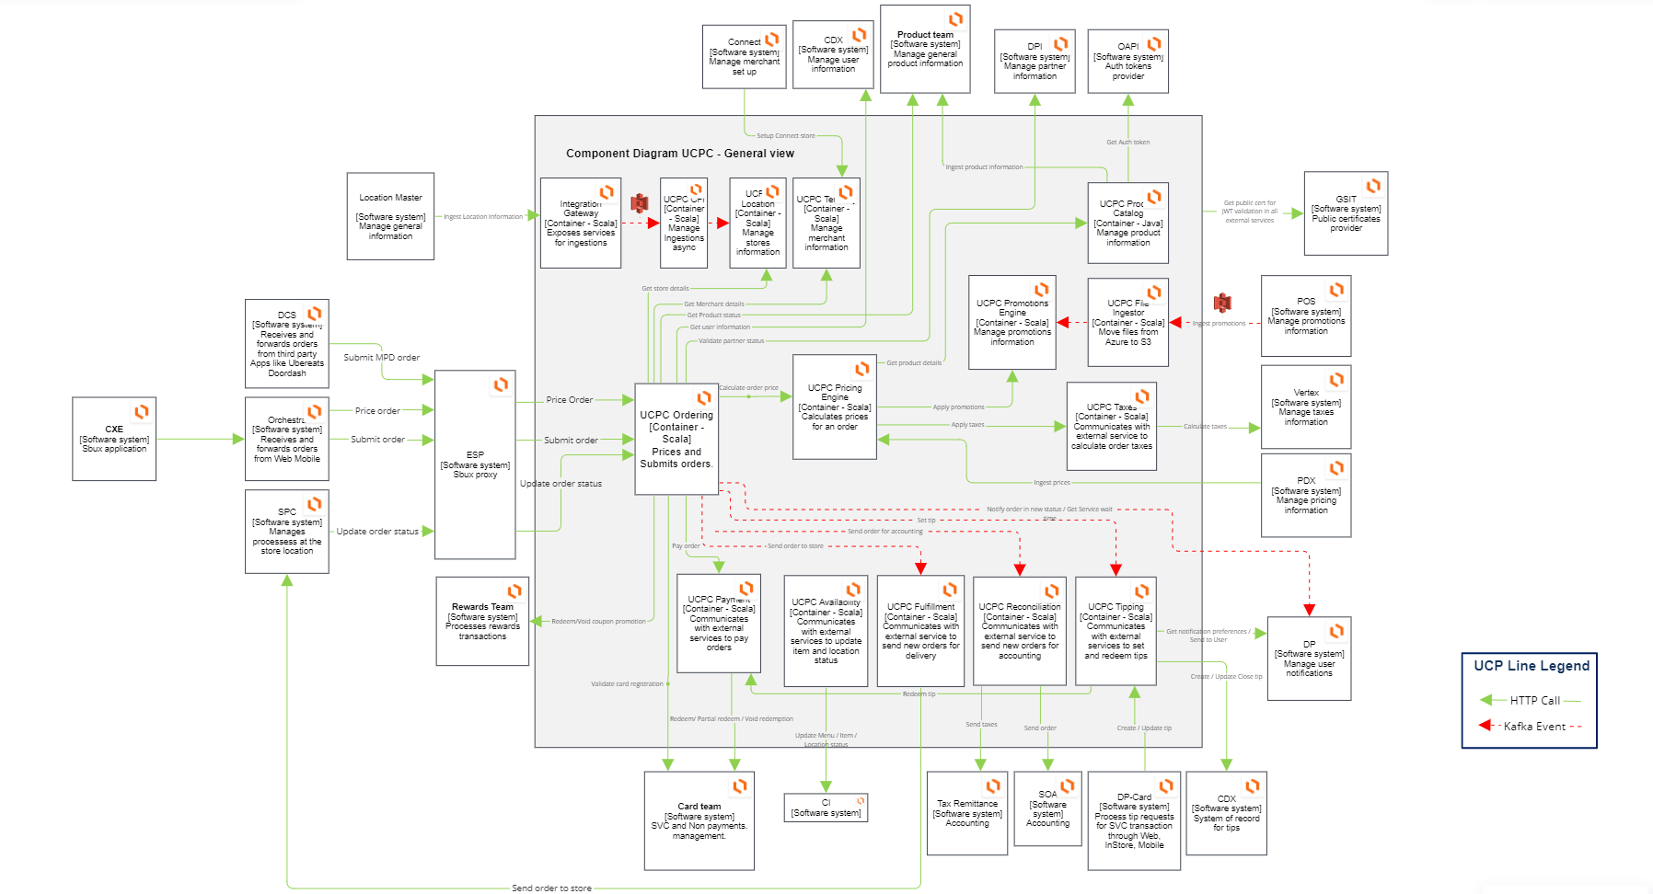
Unified Commerce Platform
UCP Engineering team
UCP Commerce builds and support modern multi-Cloud based SAAS (Software as a Service) Platform that powers Starbucks Mobile Order and Pay across various delivery channels in USA/Canada markets.
Currently supporting the following ordering channels:
Starbucks Mobile app (MOP)
Delivery Partners orders.
Next Generation Point of Sale (POS) System

Slide 4
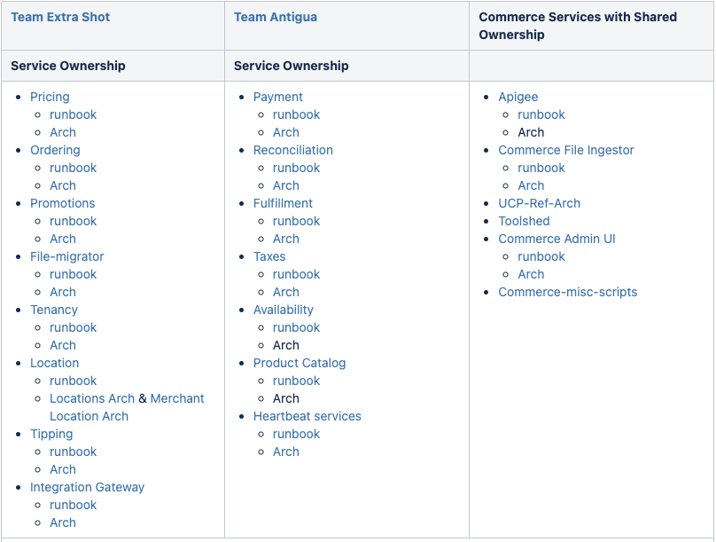
Unified Commerce Platform
UCP Engineering team
Team Extra shot owns services for order pricing
Team Antigua owns services for order fulfilment
Admin UI is co-owned by the two teams

Slide 5
Project Mission
Motivation for an admin UI tool
Why switching to React

Slide 6
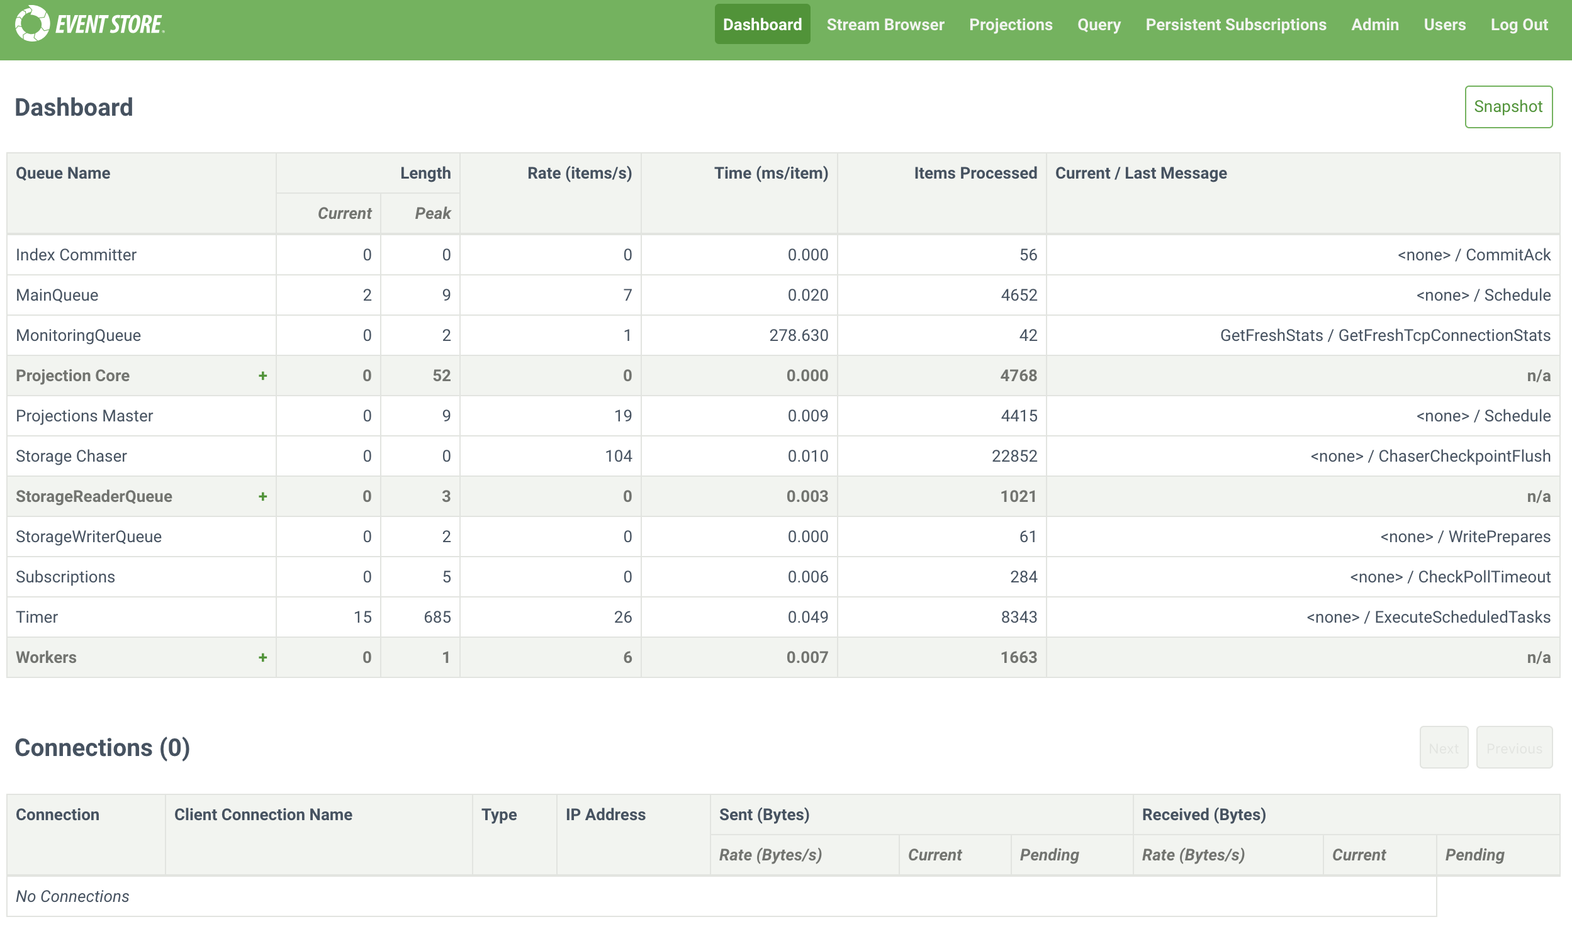
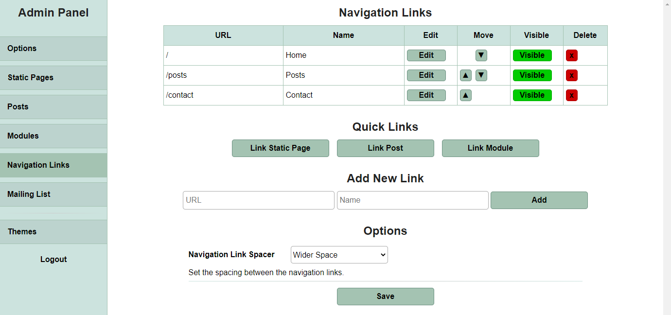
What is an Admin UI
Database management
What is an admin UI
An admin UI (administrative user interface) is a part of a software application designed specifically for administrators to manage and configure various aspects of the system.
Website management

Slide 7
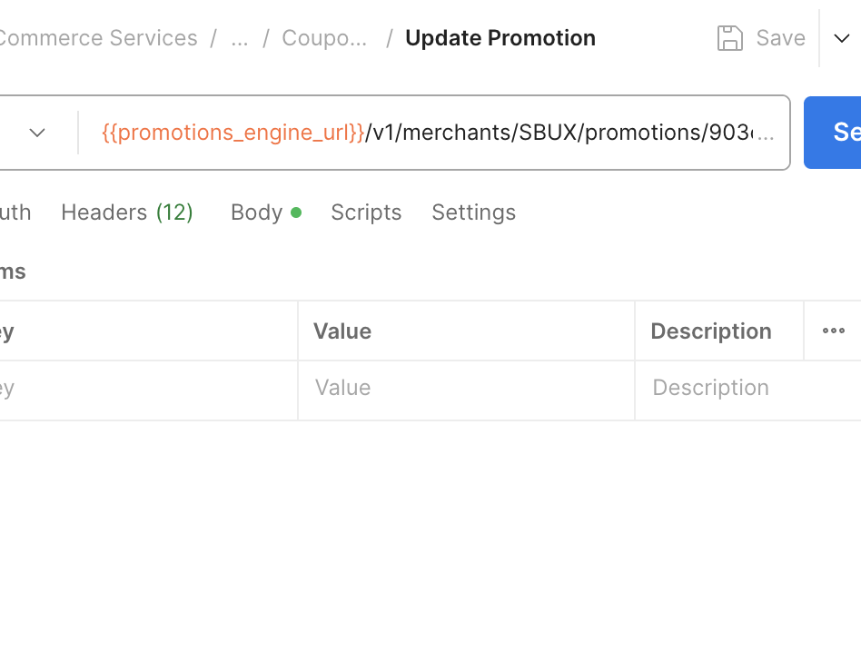
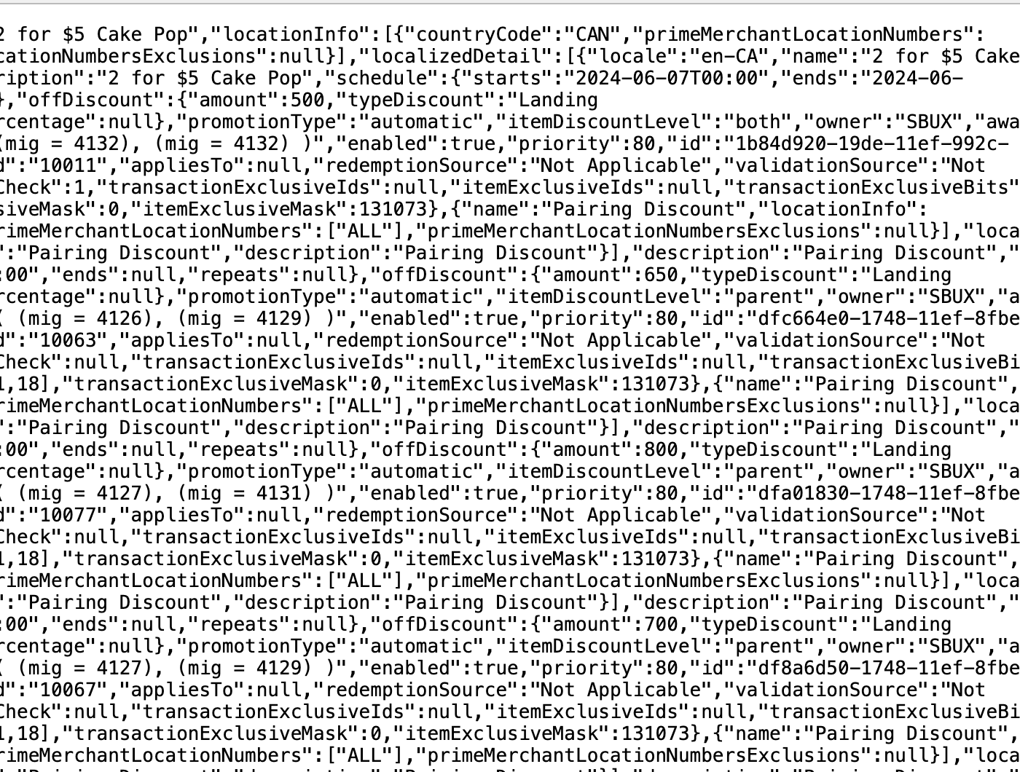

Motivation
Motivation
Location 1
Location 2
merchant
Location 4
Location 3
X 10,000
Easier bulk modification
See relationships between data
Visualize data object JSON
Avoid the pain of manually executing many Postman requests to remove duplicate promotion entries.
Provide a way to list all locations associated with a merchant, so developers don’t have to manually trace location associations from JSON outputs.
Improve the visualization of data entities, making it easier to review a data entity, without having to sift through JSON strings or the database.

Slide 8
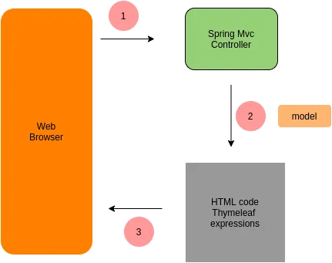
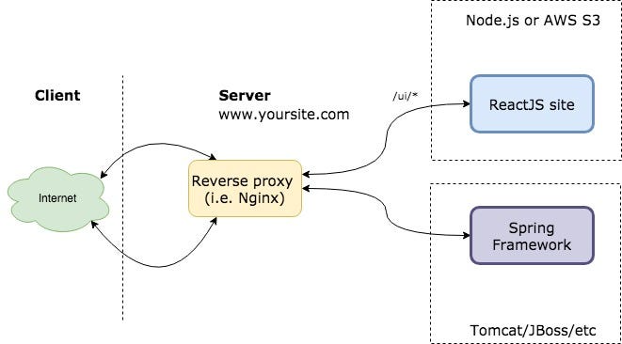
Frontend Migration
Frontend migration
Before:
After:
Spring Boot + Thymeleaf + HTML
Spring Boot + React
Per user request,
Spring Boot receives and processes the request and sends data models to the viewer
Thymeleaf processes the data and generate html
Html is sent to the browser and rendered
Per user request,
React makes AJAX calls to Spring Boot rest APIs
Spring Boot processes the request and sends back JSON response
React processes JSON data on client side and updates the DOM dynamically

Slide 9
Project Deliverables
Demo
Impact

Slide 10
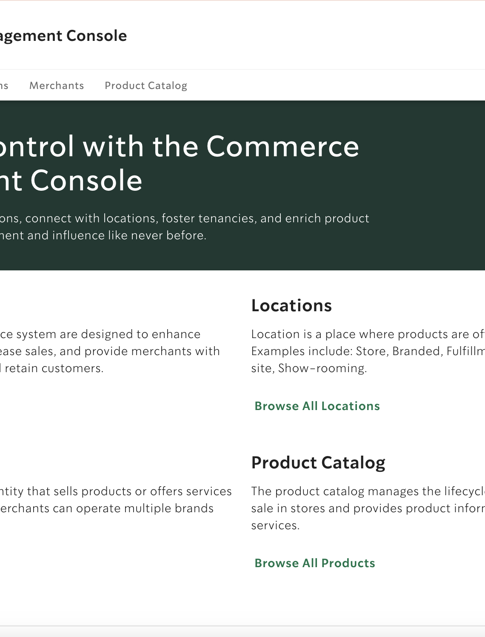
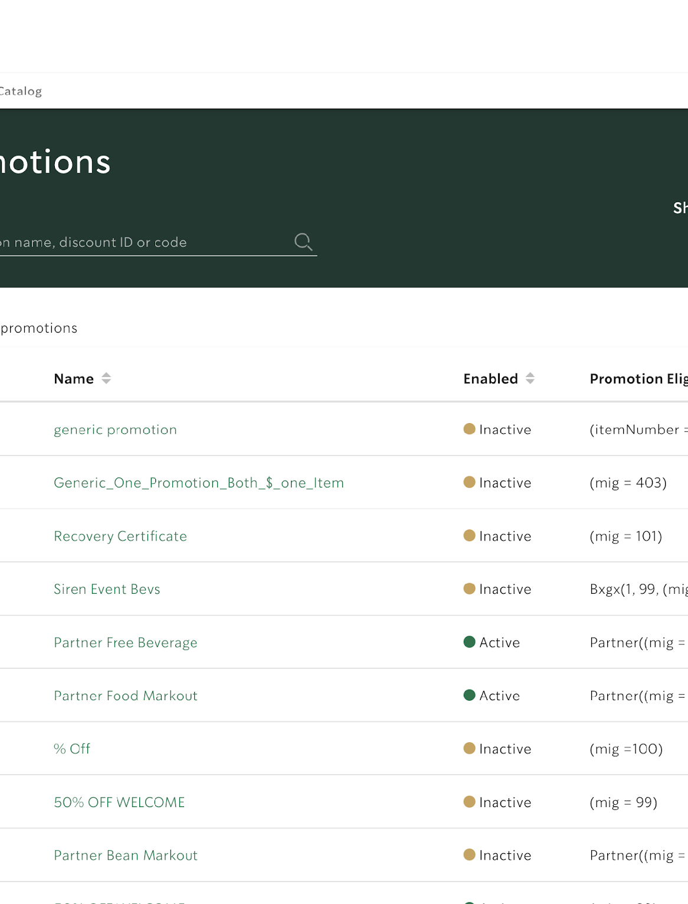
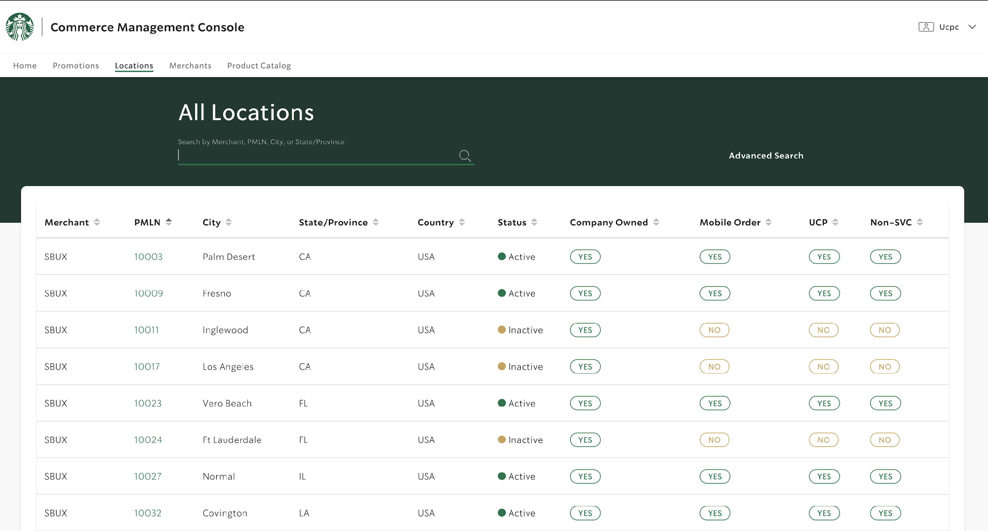
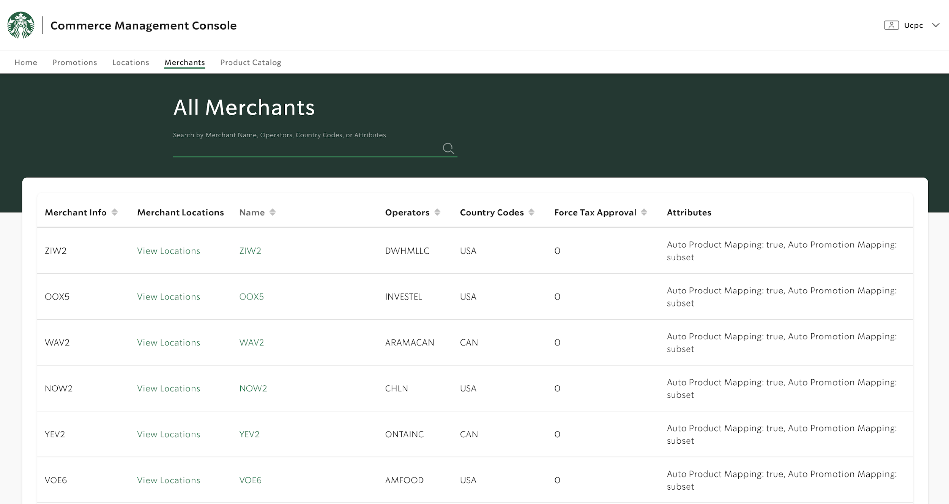
Screens
Screens
Home
Promotions
Locations
Merchants

Slide 11
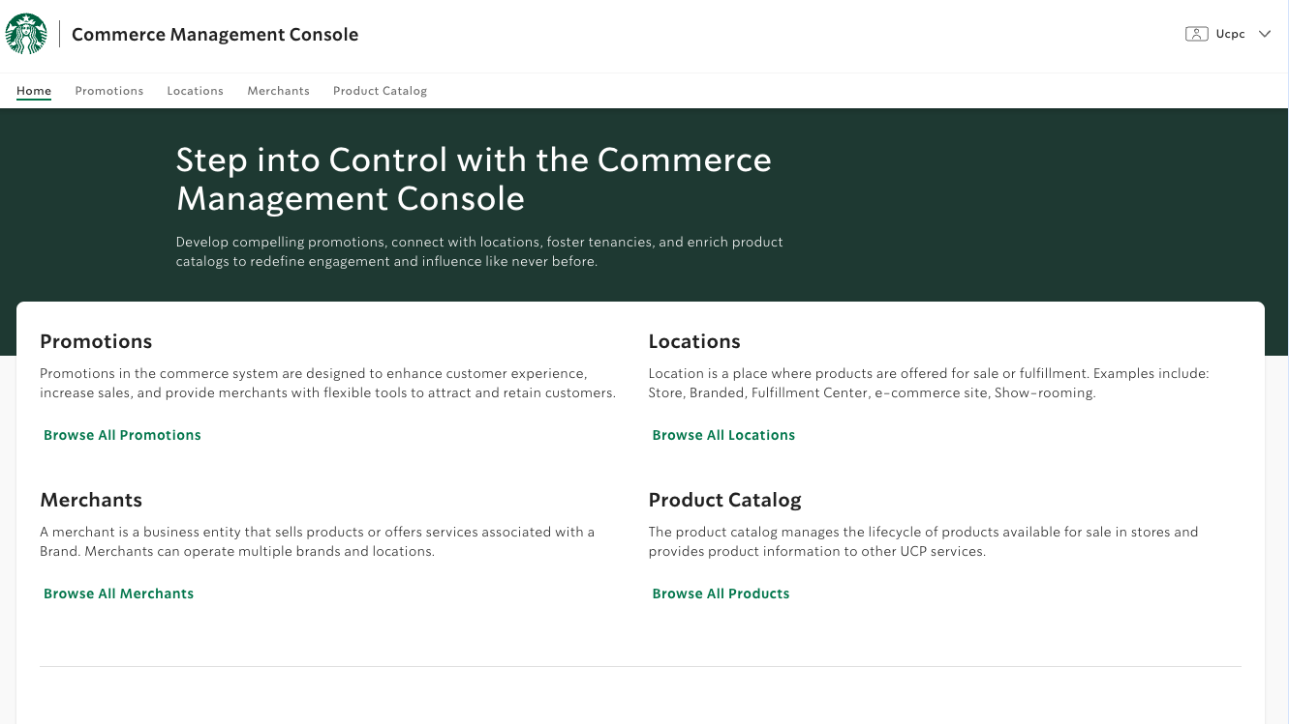

Slide 12
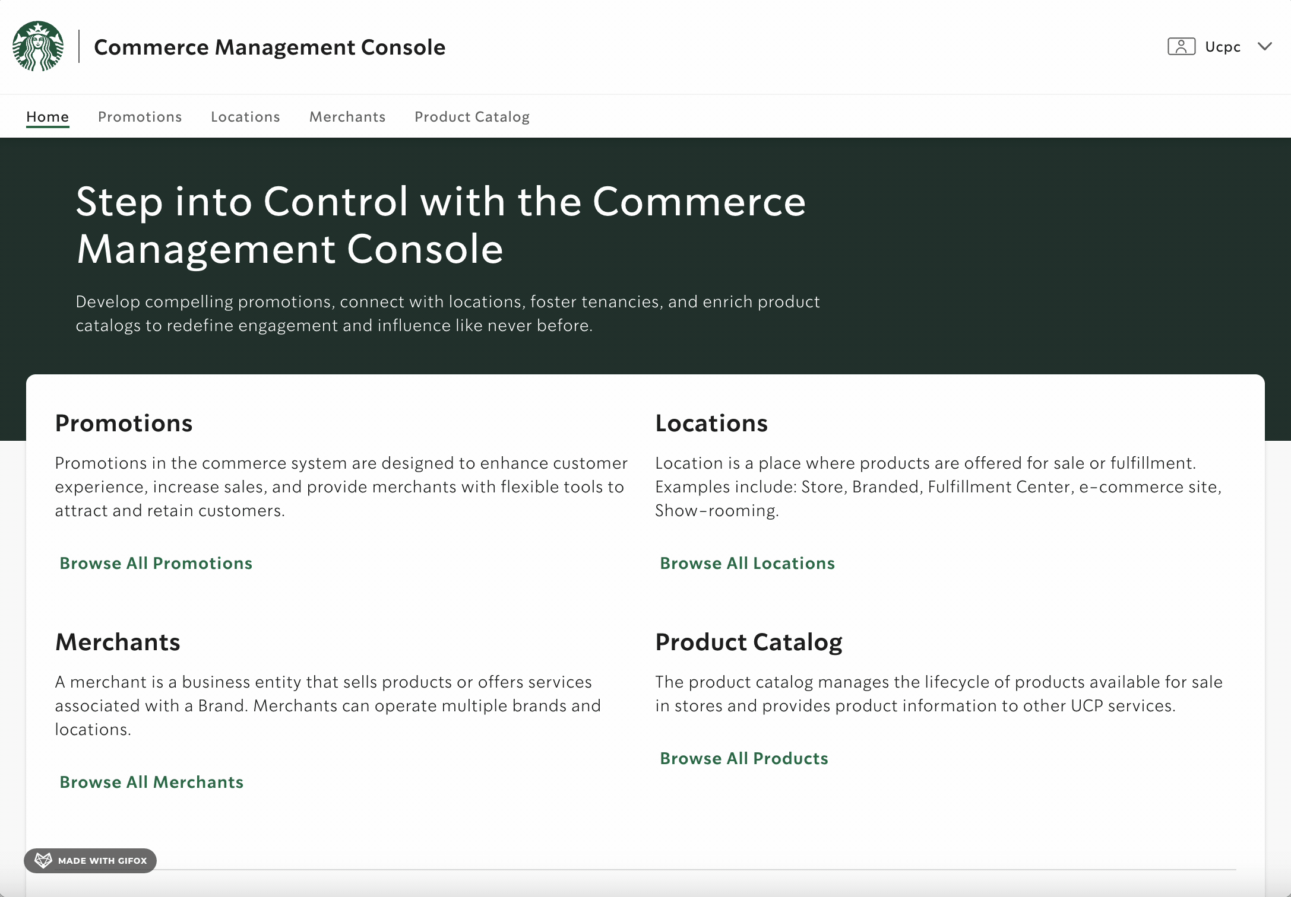
Table and pagination
Homepage and
page navigation

Slide 13
Promotions Screen
Promotions Screen
Sort
Search
Bulk select and Edit
Cleanup duplicates
Sort the list of promotions by any column in ascending or descending order
Implementation: custom hook to manage sort config with `useState`,and Javascript `Array.prototype.sort()` for sorting.
Search for promotions based on specific fields
Implementation: `useState`to store the search term, and ` Array.prototype.filter()` for filtering.
Select multiple or all promotions from the list and perform bulk actions (enabling or disabling them)
Implementation: custom hook to handle row selection, TanStack `useMutation` for query to backend to edit data.
Remove redundant promotions to maintain a clean database
Implementation: `Array.prototype.reduce()`for computing duplicates, TanStack `useMutation` for query to backend to delete data.

Slide 14
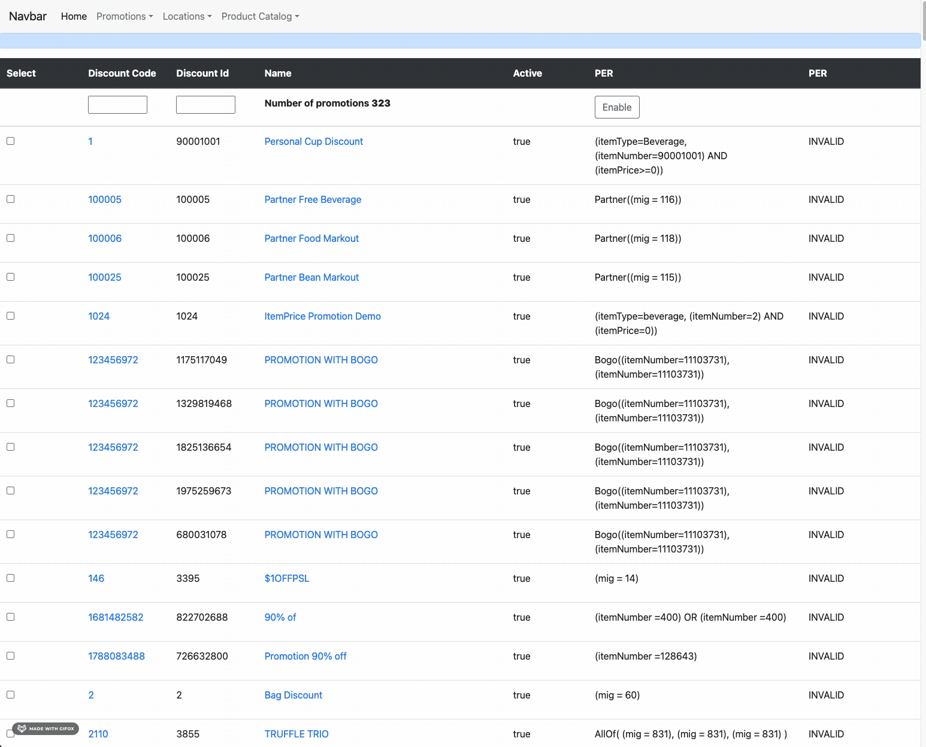
Table in the old UI

Slide 15
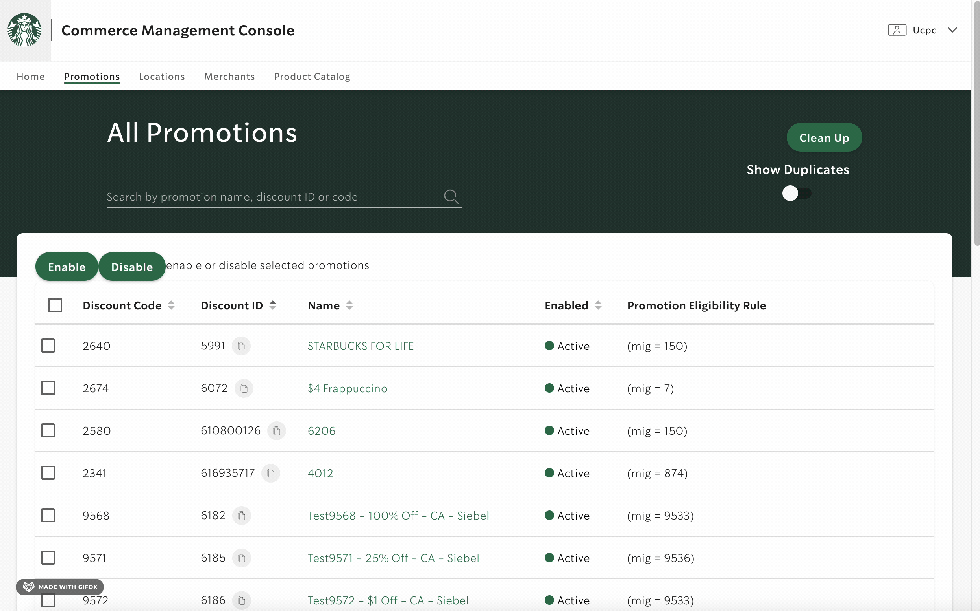
Table and pagination

Slide 16
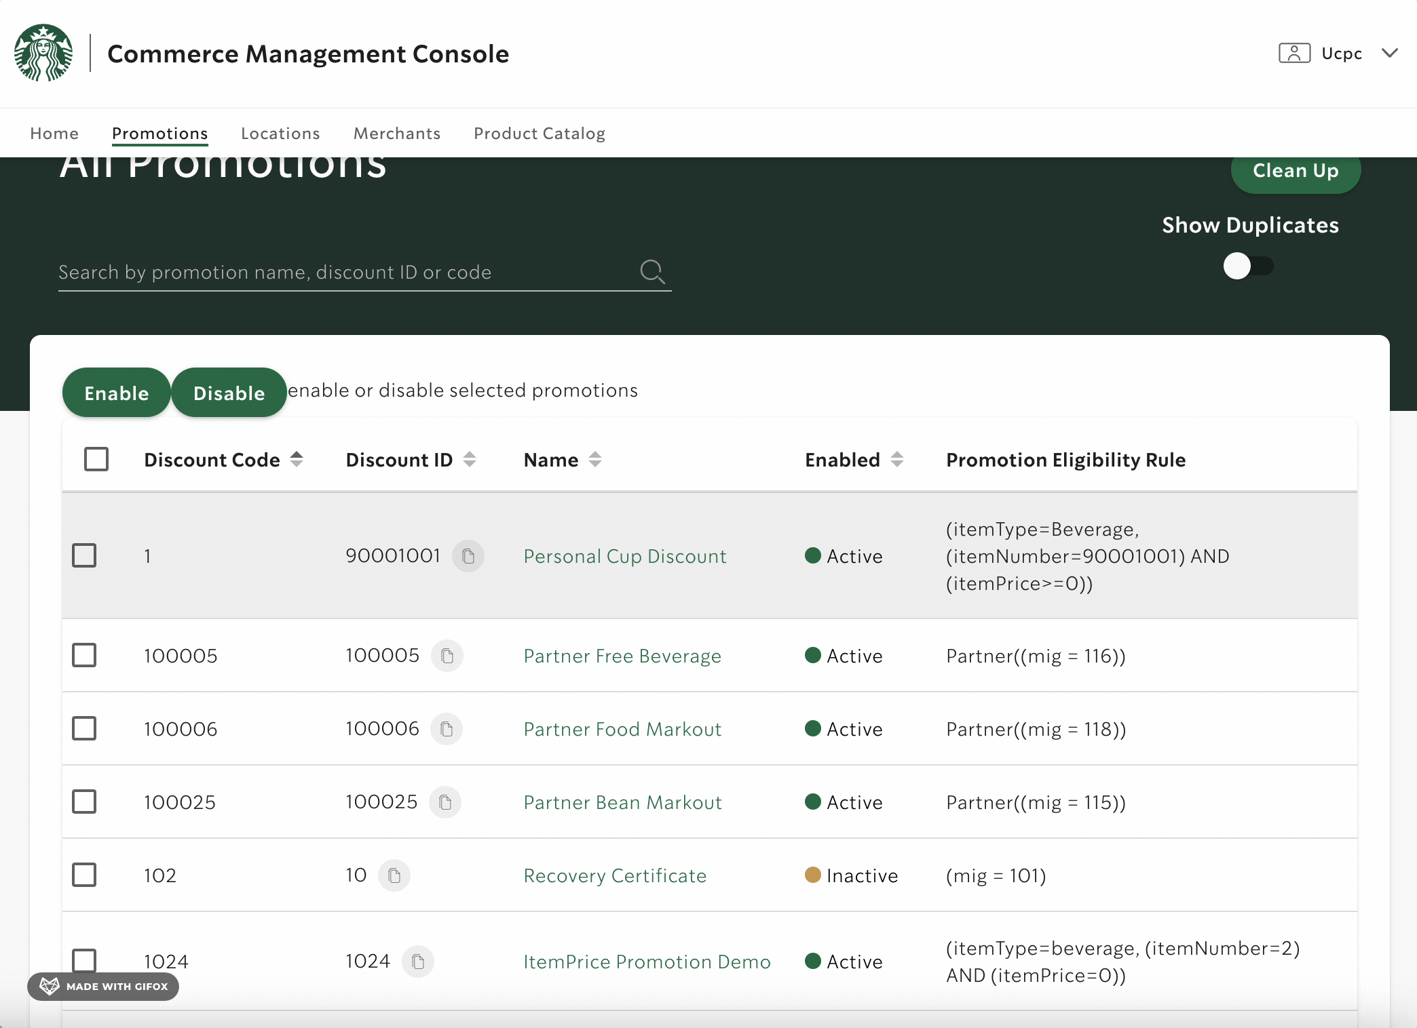
Sorting
Sort the list of promotions by any column in ascending or descending order.

Slide 17
Searching in the old UI

Slide 18
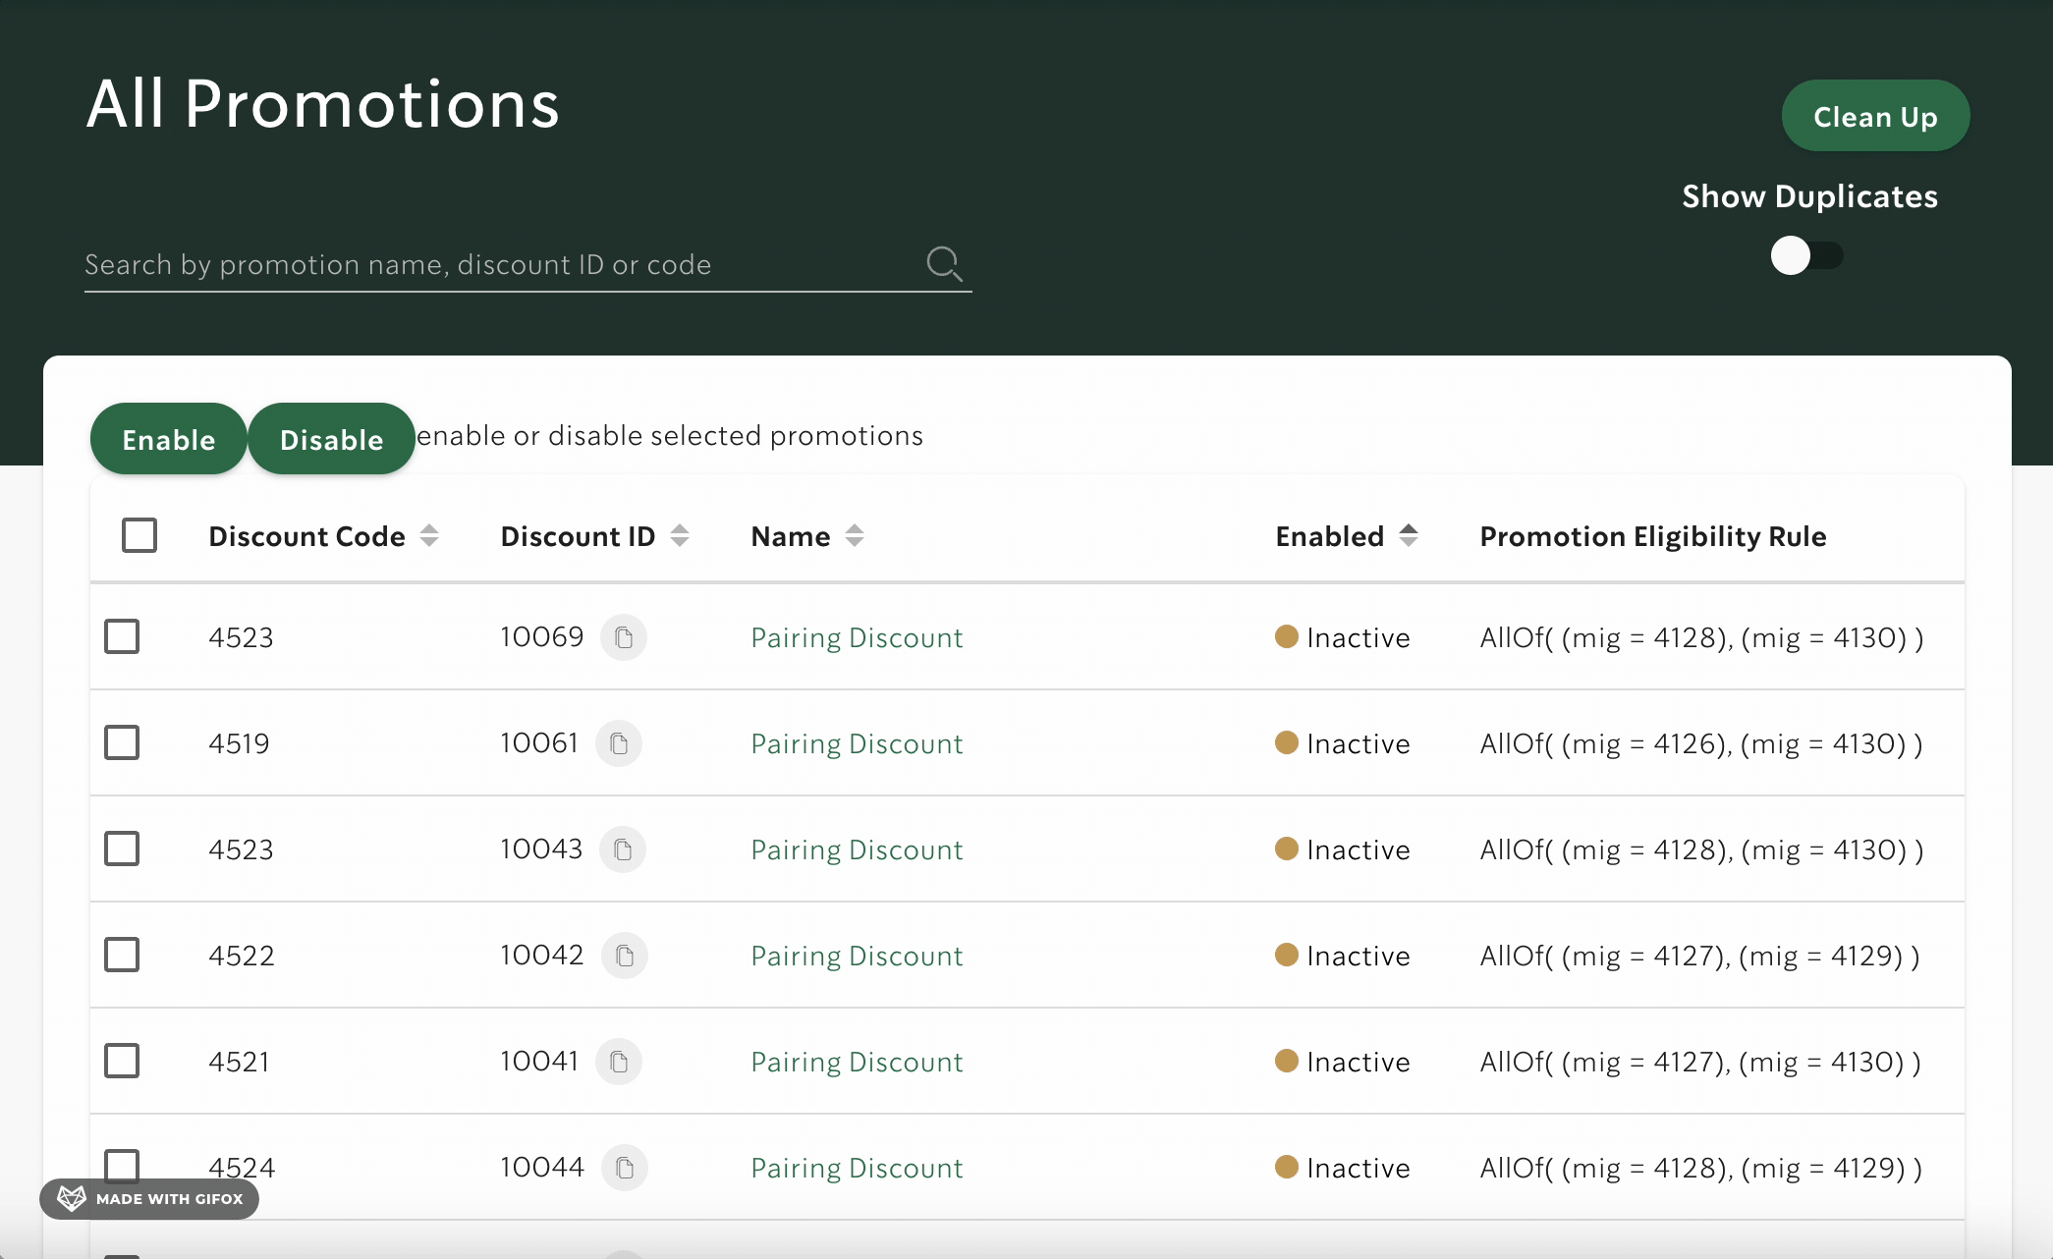
Searching
Search for promotions that matches a certain user input on any of the fields

Slide 19
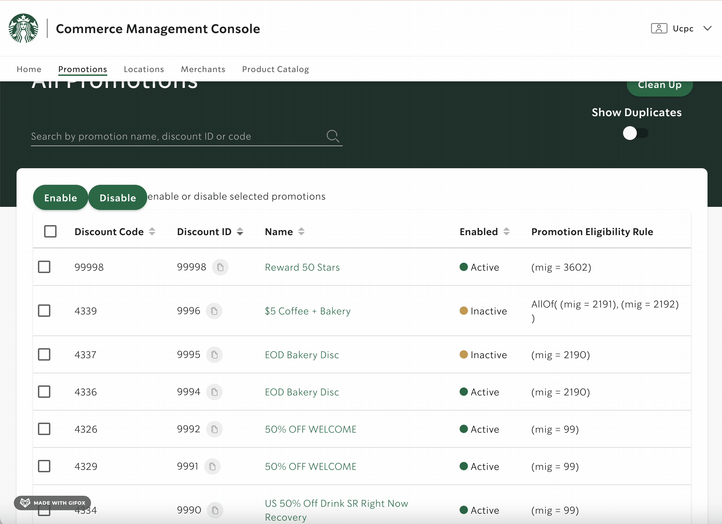
Enable or disable promotions
Select multiple or all promotions from the list and perform bulk actions (enabling or disabling them)

Slide 20
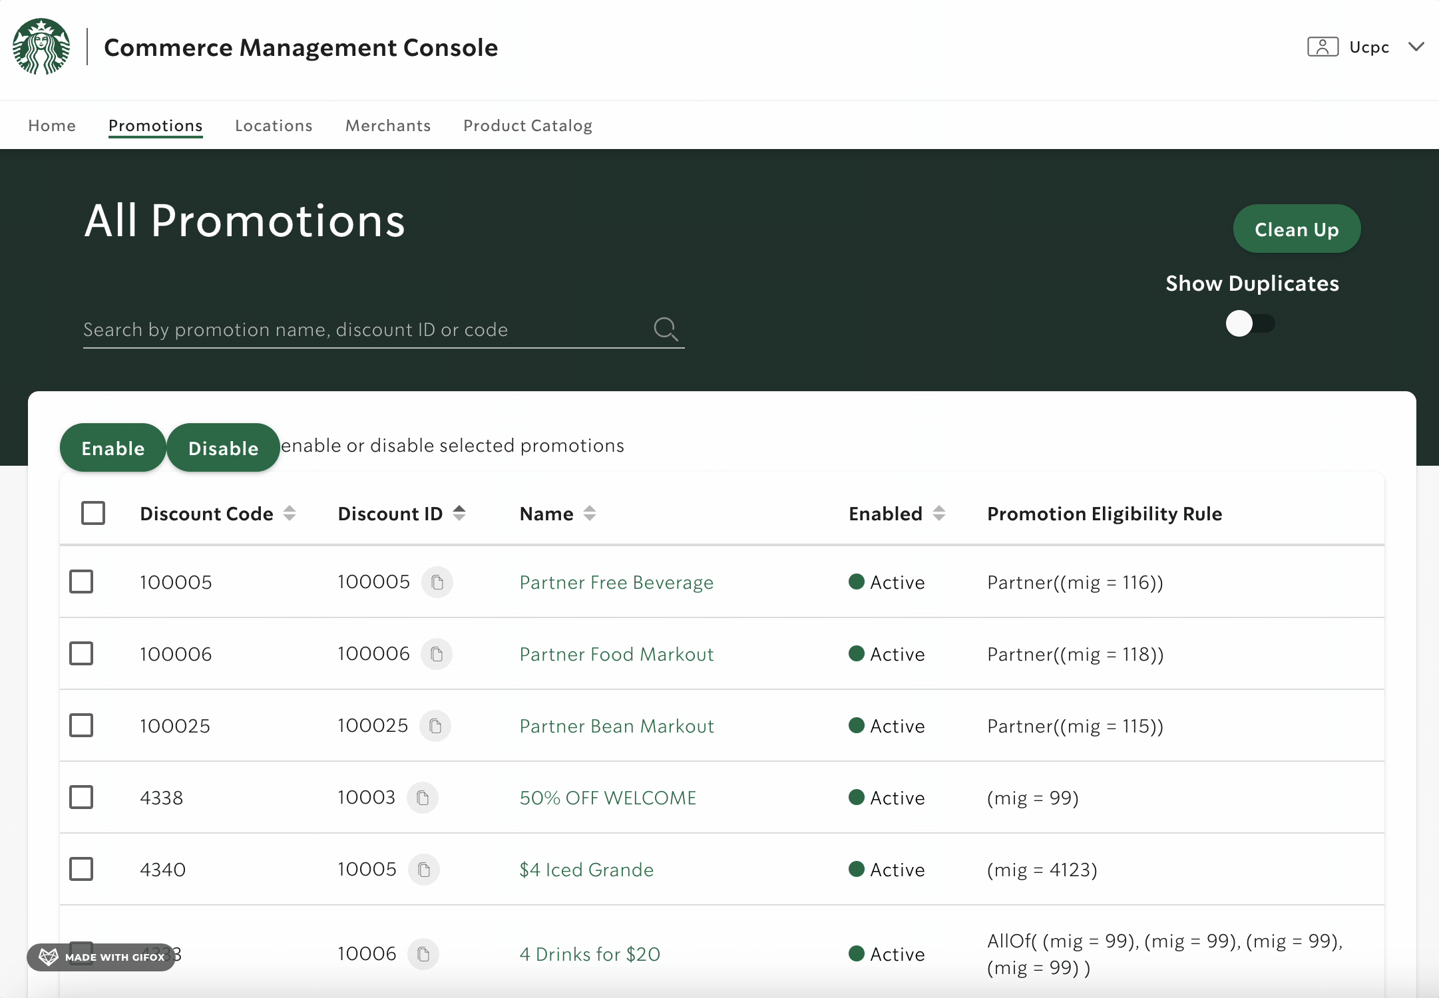
Cleanup duplicates
Clean up duplicates
Remove duplicated promotions to ensure each promotion has a unique combination of discount code and discount ID.

Slide 21
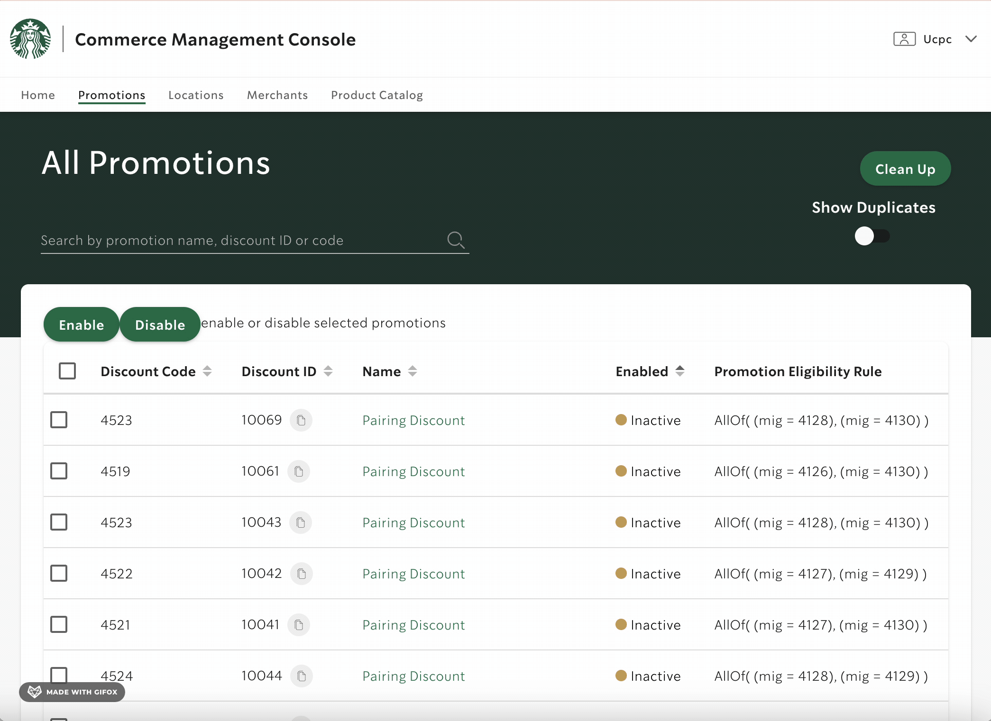
Detail page for a single promotion
Spring. boot

Slide 22
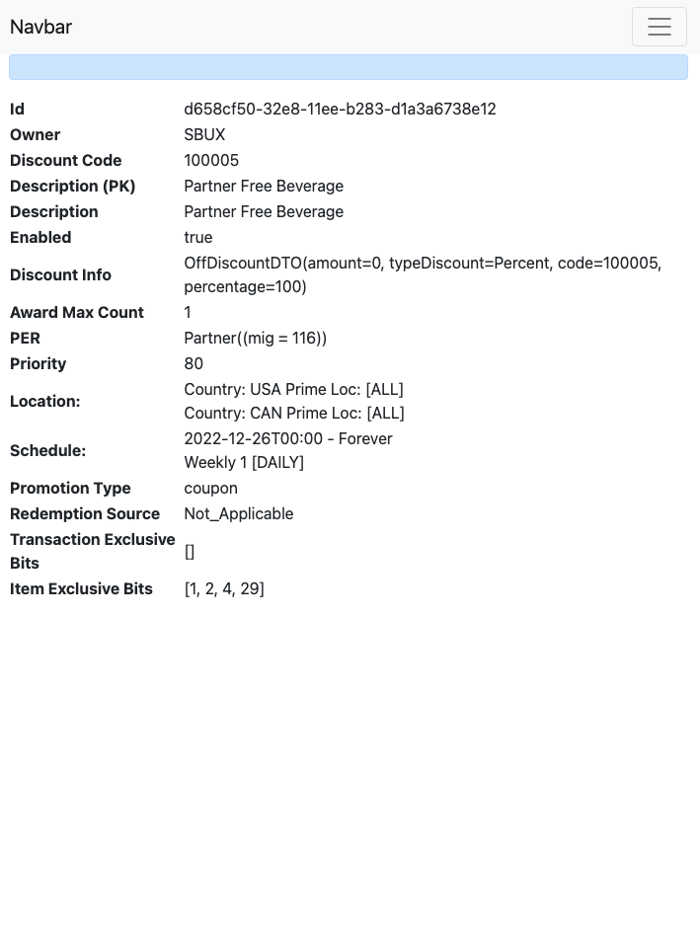
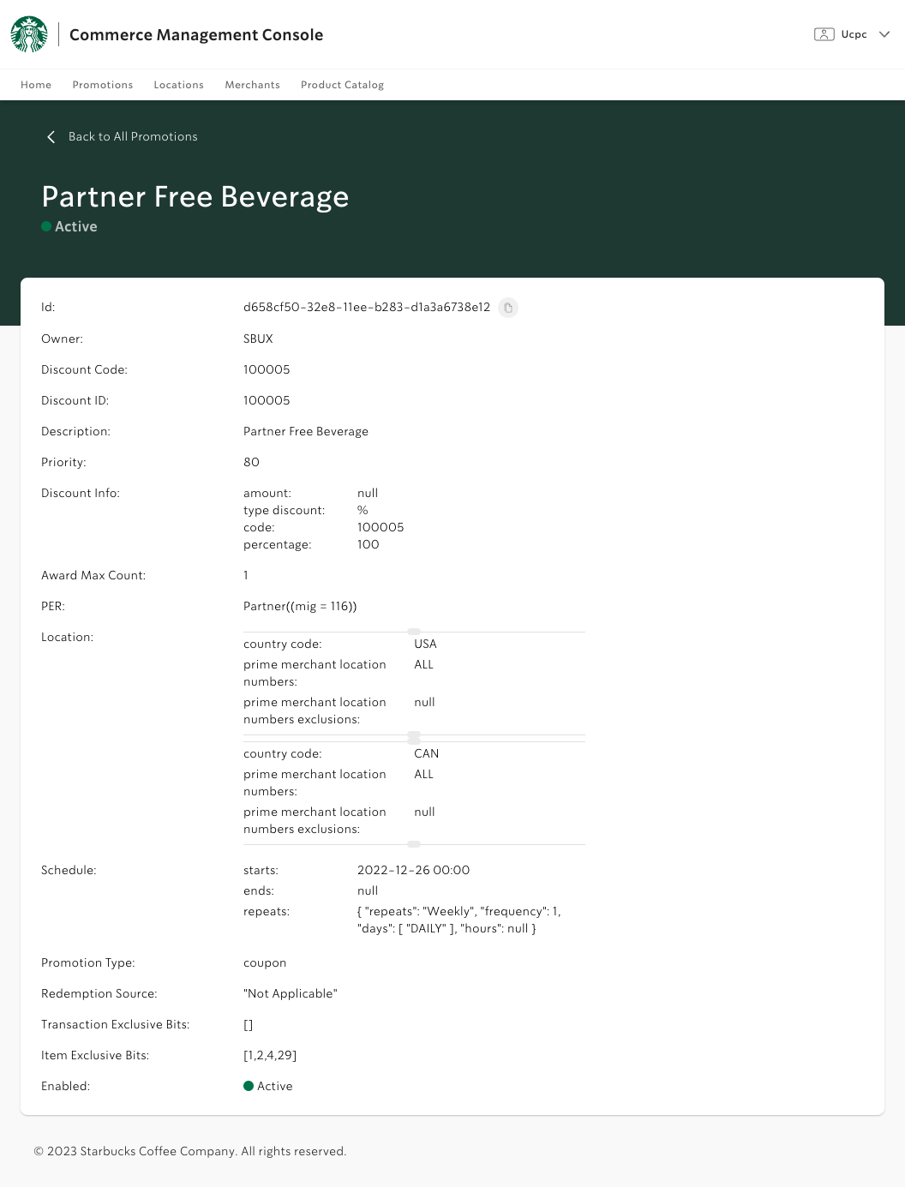
Detail page
Detail page comparison

Slide 23
Locations Screen
Locations Screen
Sort
Search
Advanced Search
Sort the list of locations by any column in ascending or descending order.
Implementation: custom hook to manage sort config with `useState`,and Javascript `Array.prototype.sort()` for sorting.
Search for locations based on specific fields.
Implementation: `useState`to store the search term, and ` Array.prototype.filter()` for filtering.
Search using specific fields, with dropdown selections for 'State' and 'Country' that automatically synchronize.
Implementation: `Array.prototype.reduce()` to compile select options for dropdowns, and `useEffect` hook to update the ‘Country' field when a 'State' is selected.

Slide 24
Advanced Search
Searching with specific fields, with auto-filling for states and country

Slide 25
Advanced Search
Combined with general search

Slide 26
Merchants Screen
Merchants Screen
Sort
Search
List of merchant locations
Sort the list of merchants by any column in ascending or descending order.
Implementation: custom hook to manage sort config with `useState`,and Javascript `Array.prototype.sort()` for sorting.
Search for merchants based on specific fields.
Implementation: `useState`to store the search term, and ` Array.prototype.filter()` for filtering.
Display a list of locations under the merchant.
Implementation: Tanstack `useQuery` to query the database for the list, data display similar to locations screen.

Slide 27
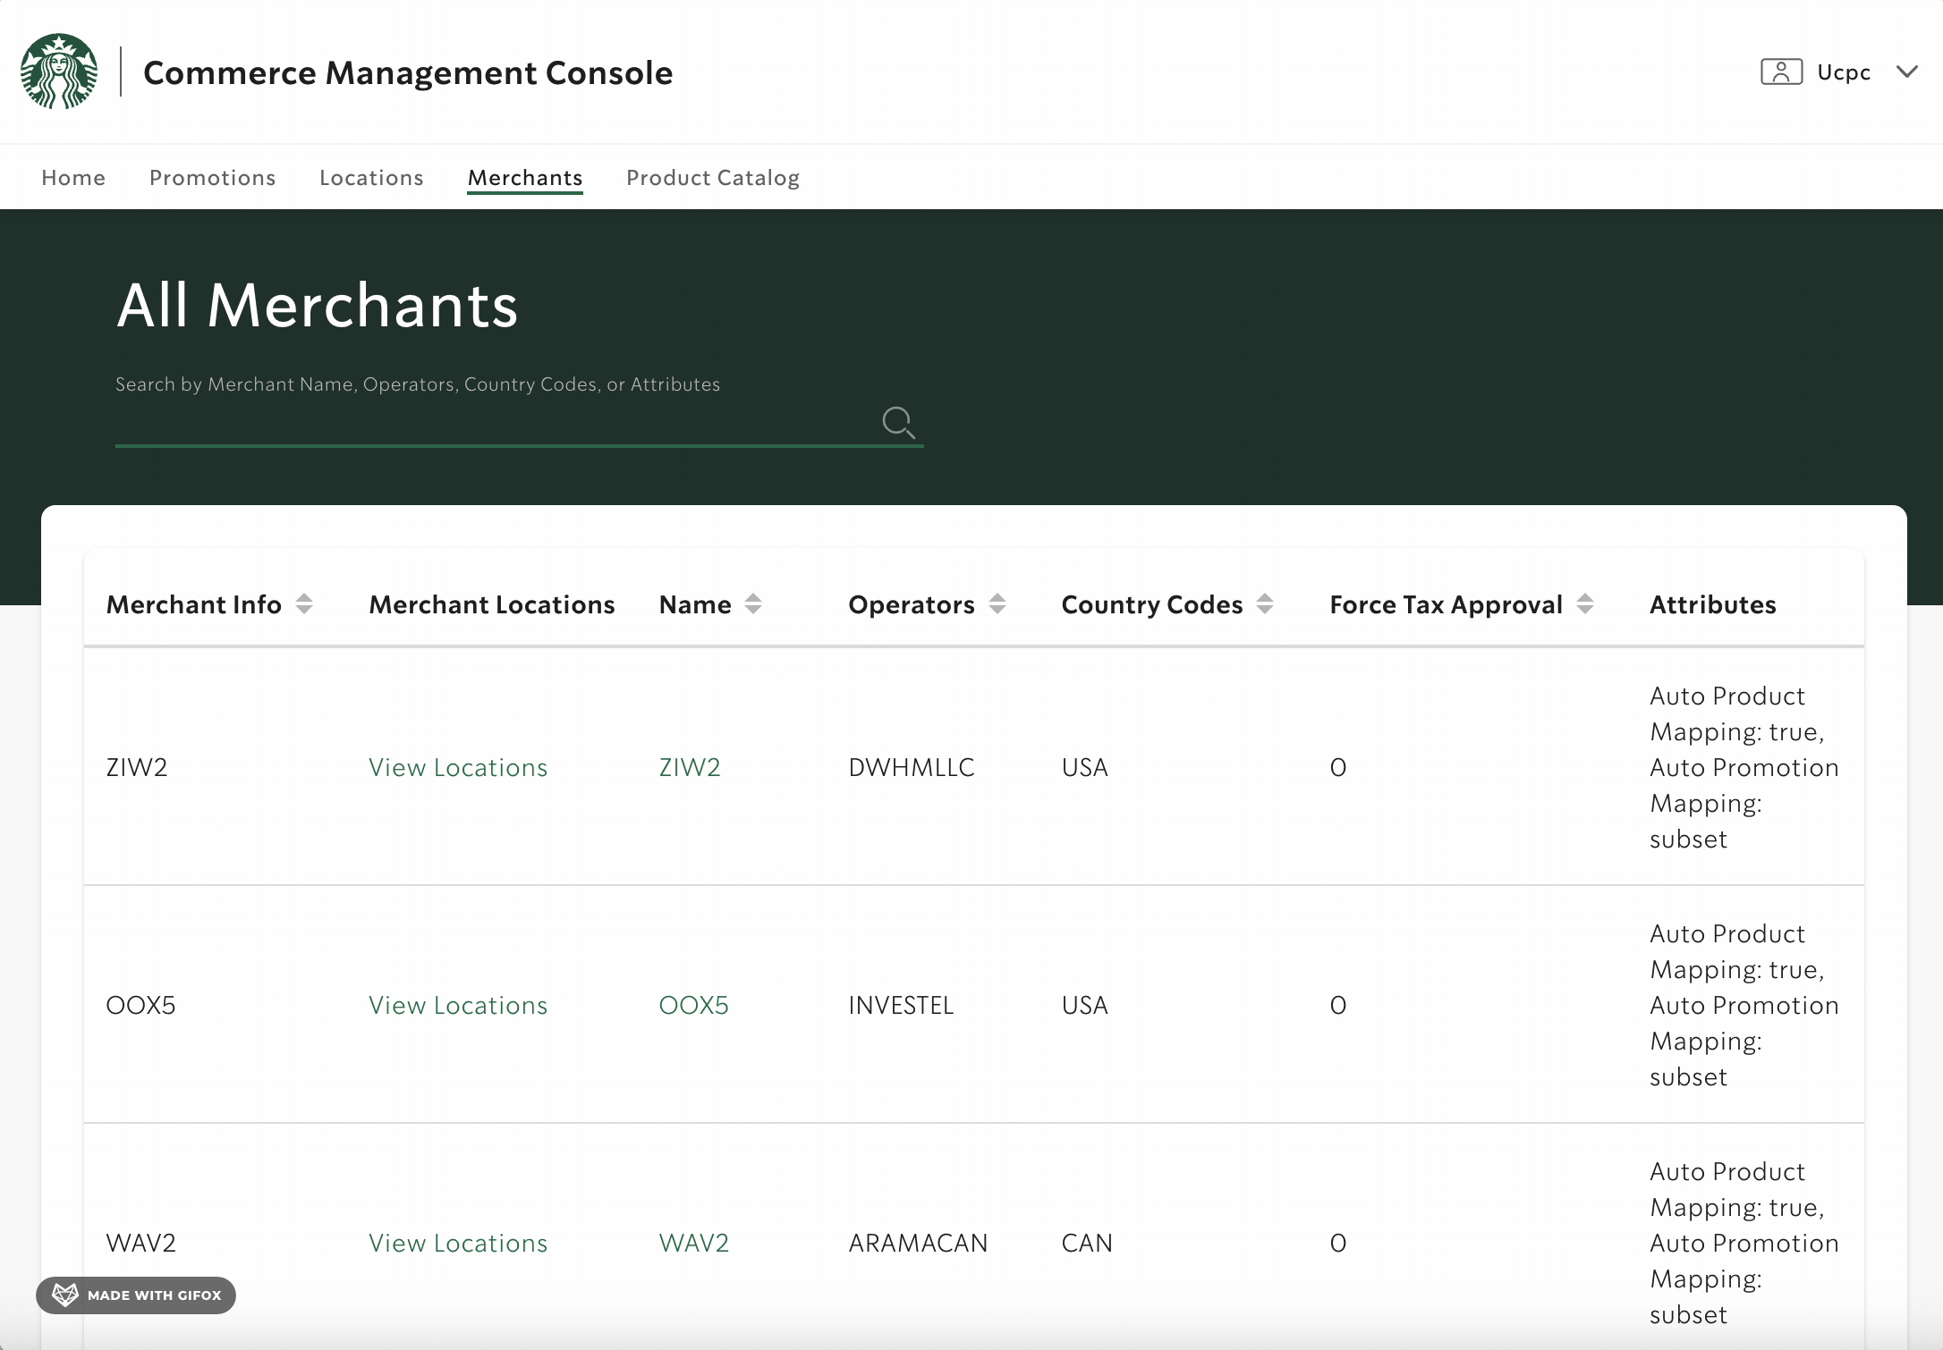
Merchant locations
Connecting merchants with locations

Slide 28
Impact
Impact
More user-friendly, easy-to-use, cost-saving data display and management that adheres to modern industry standards.
Made the below future functionalities possible:
Integrate with Starbucks' single sign-on to enable tool access by a wider range of partners.
Provide an interface to build an order right here rather than running it through the services via Postman calls.
Automate the current manual processes of testing, applying future promotions to orders, and pricing to-be-released products.

Slide 29
Project Evolution
Project timeline
Challenges

Slide 30
Project timeline
Deployment to lower env
Code cleanup
Setup, authorization
Deploy the service to lower environment and monitor the condition of the pods.
Set up environment variables and proxies to enable backend calls.
Remove log statements, commented out codes and unused files to keep the code base clean.
Computer and tools setup,
Getting authorized to use S4 components library,
Locally running the backend.
Frontend development
Writing unit tests
Writing documentation
Clarify the objectives before beginning to code. Provide updates during daily stand-up meetings and maintain regular check-ins with mentor or manager to receive feedback
Writing unit tests that runs per code push to GitHub to ensure that all page components function correctly.
Give developers instructions for coding, deploying and running the application.

Slide 31
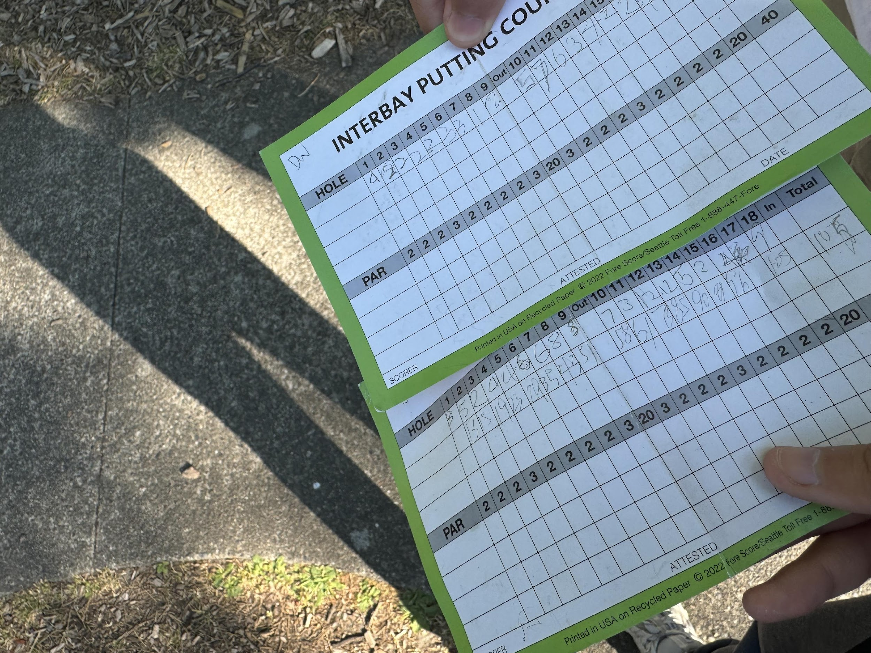
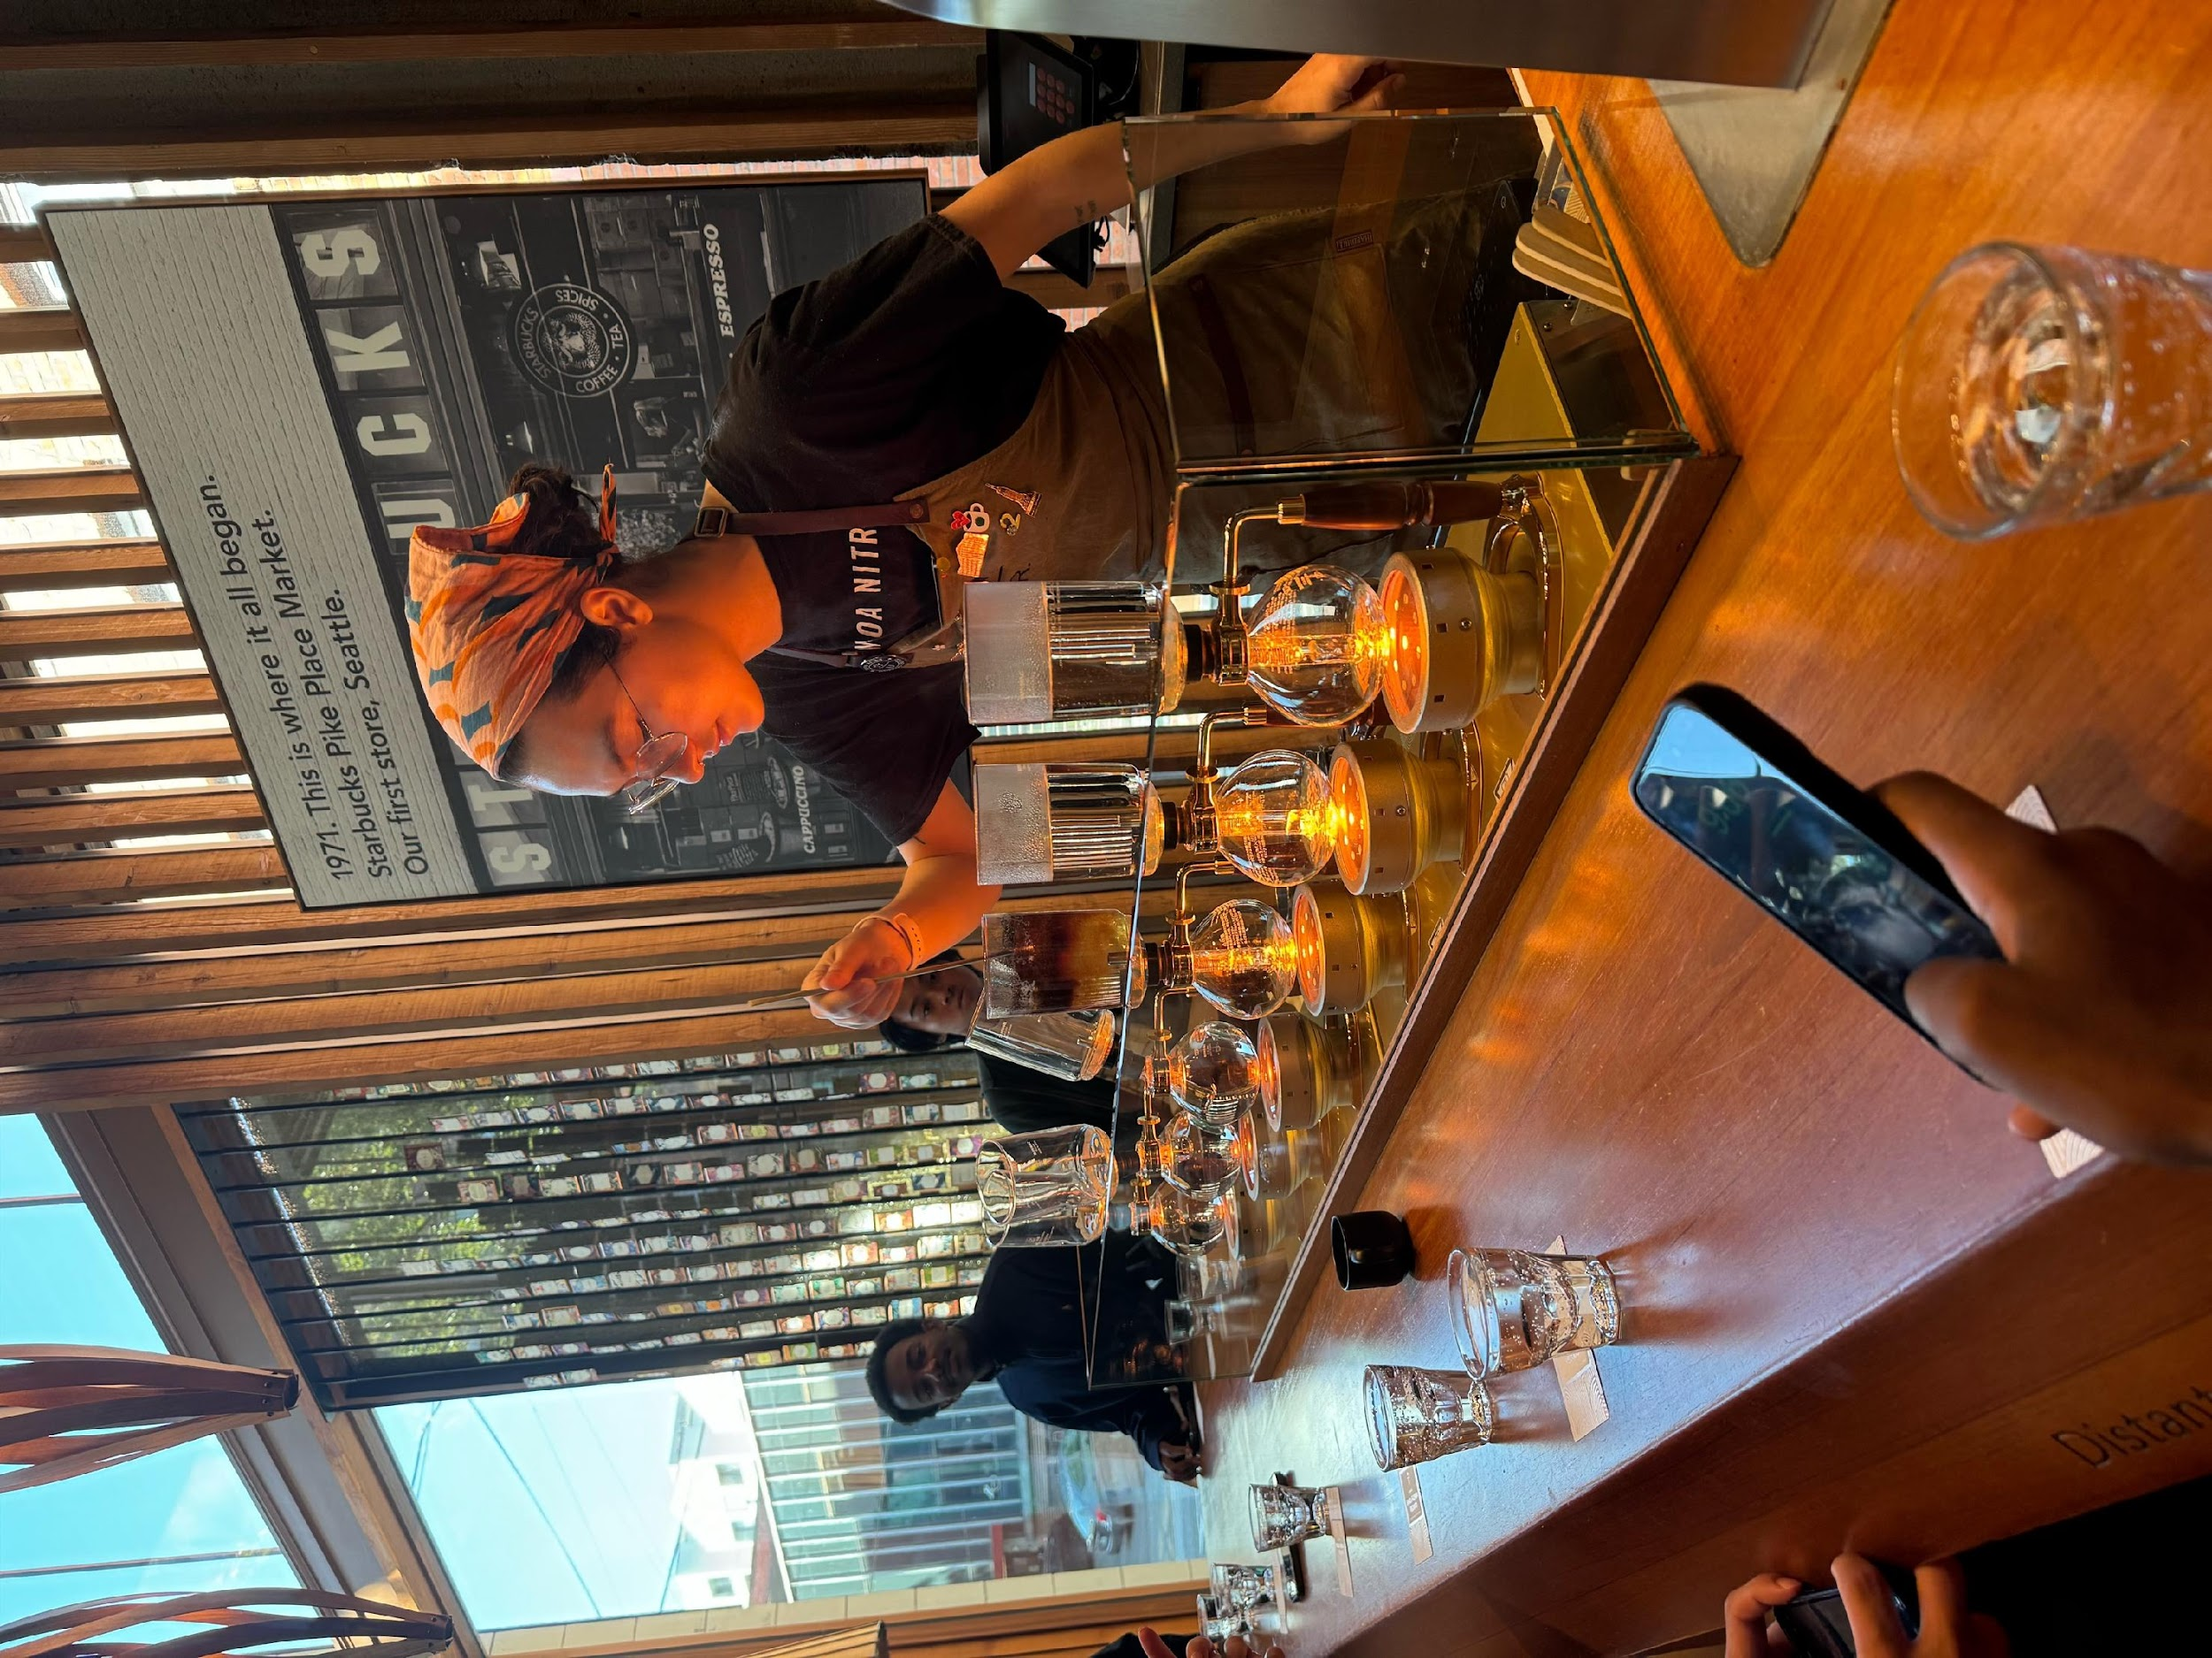
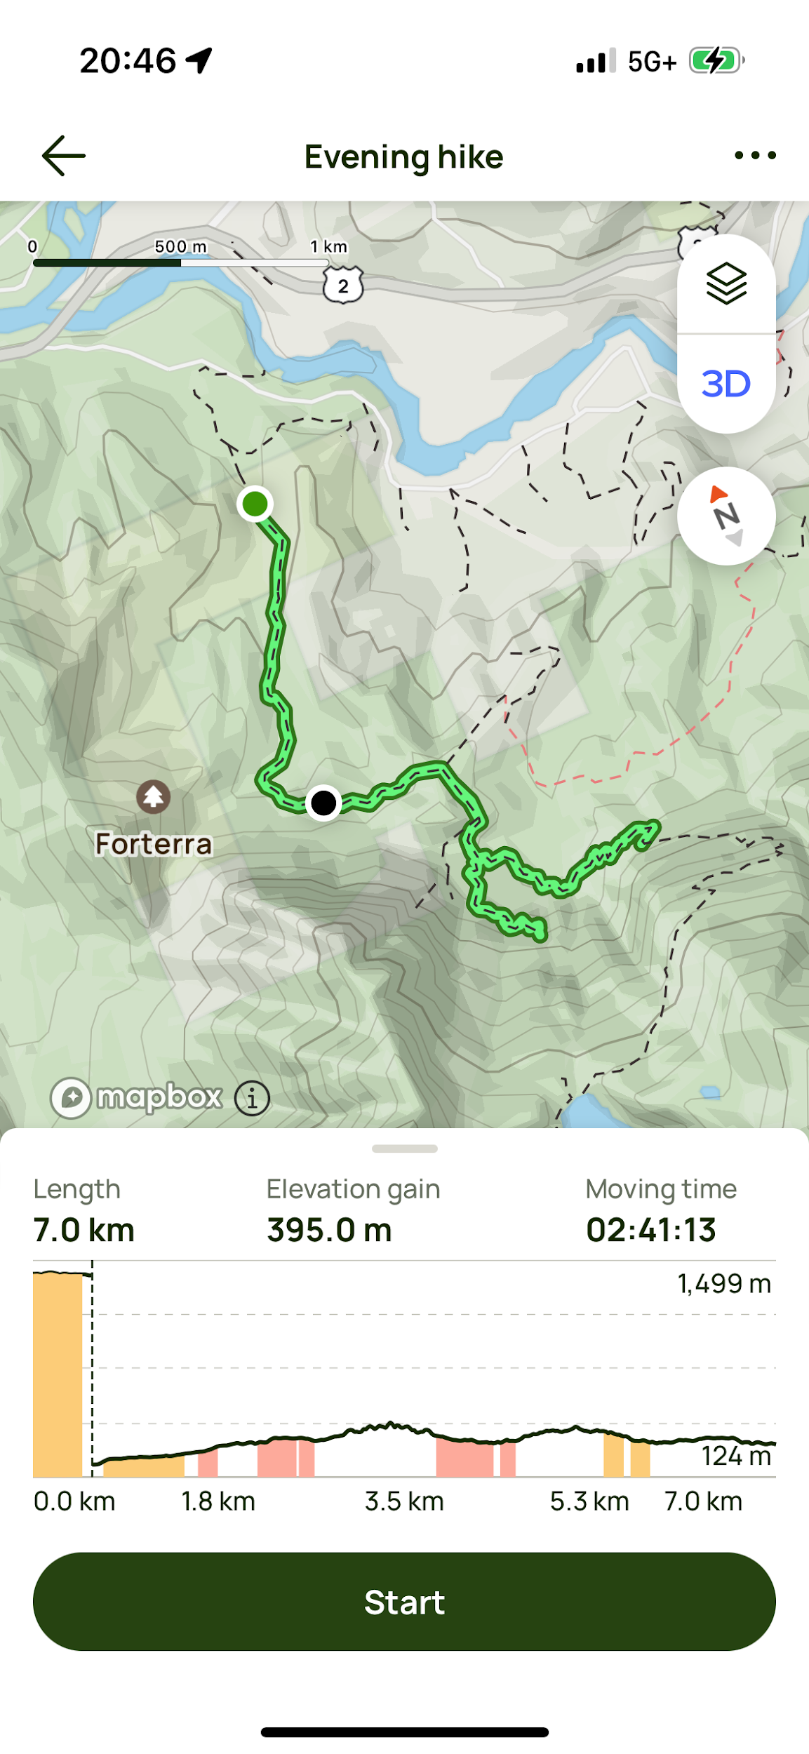
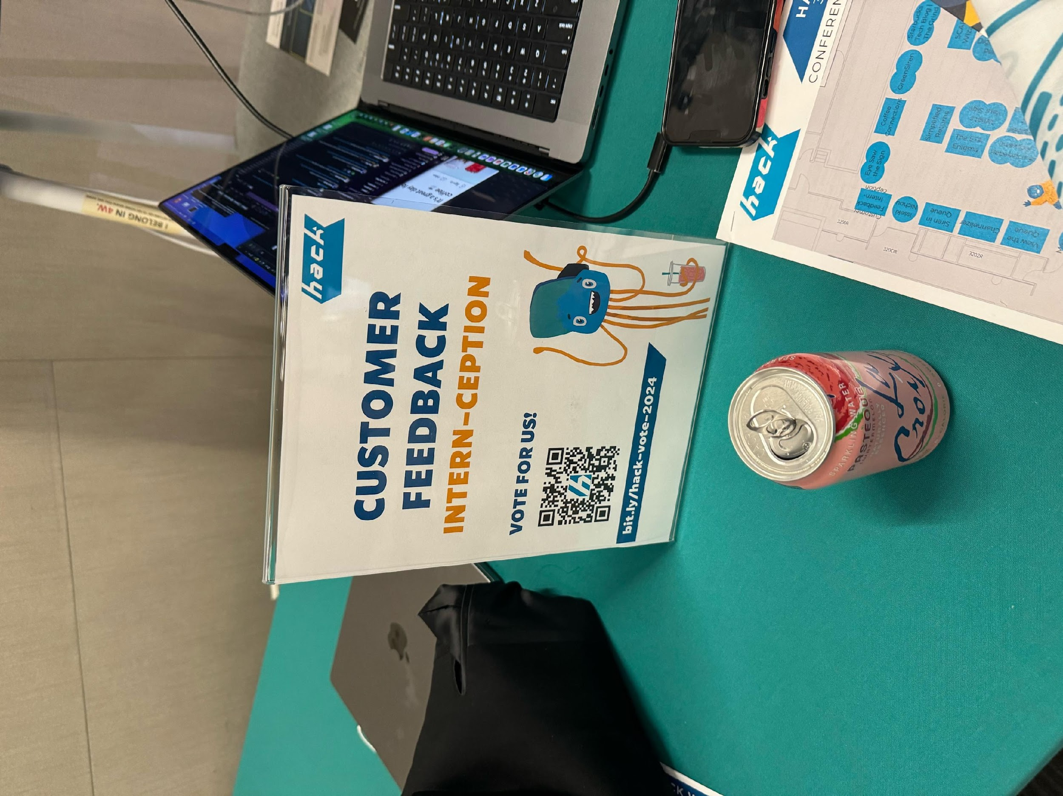

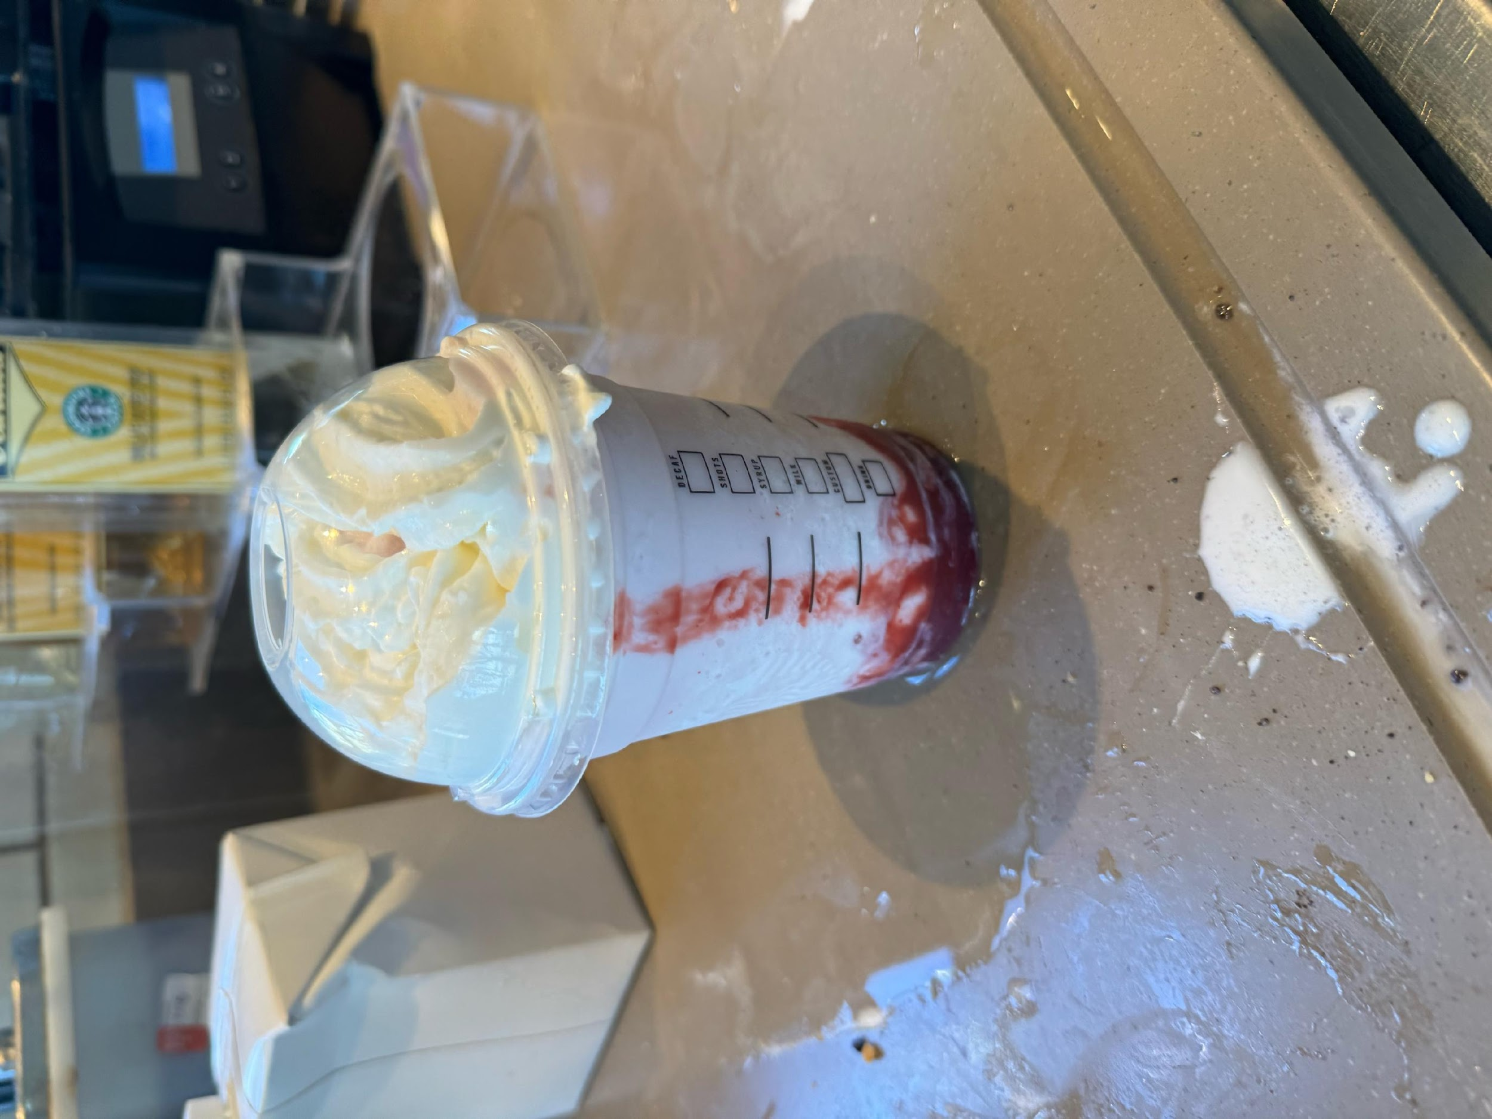
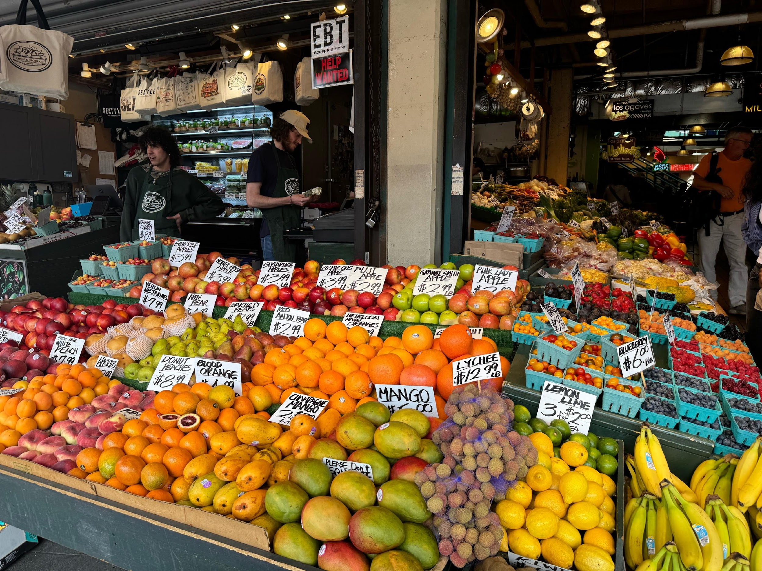


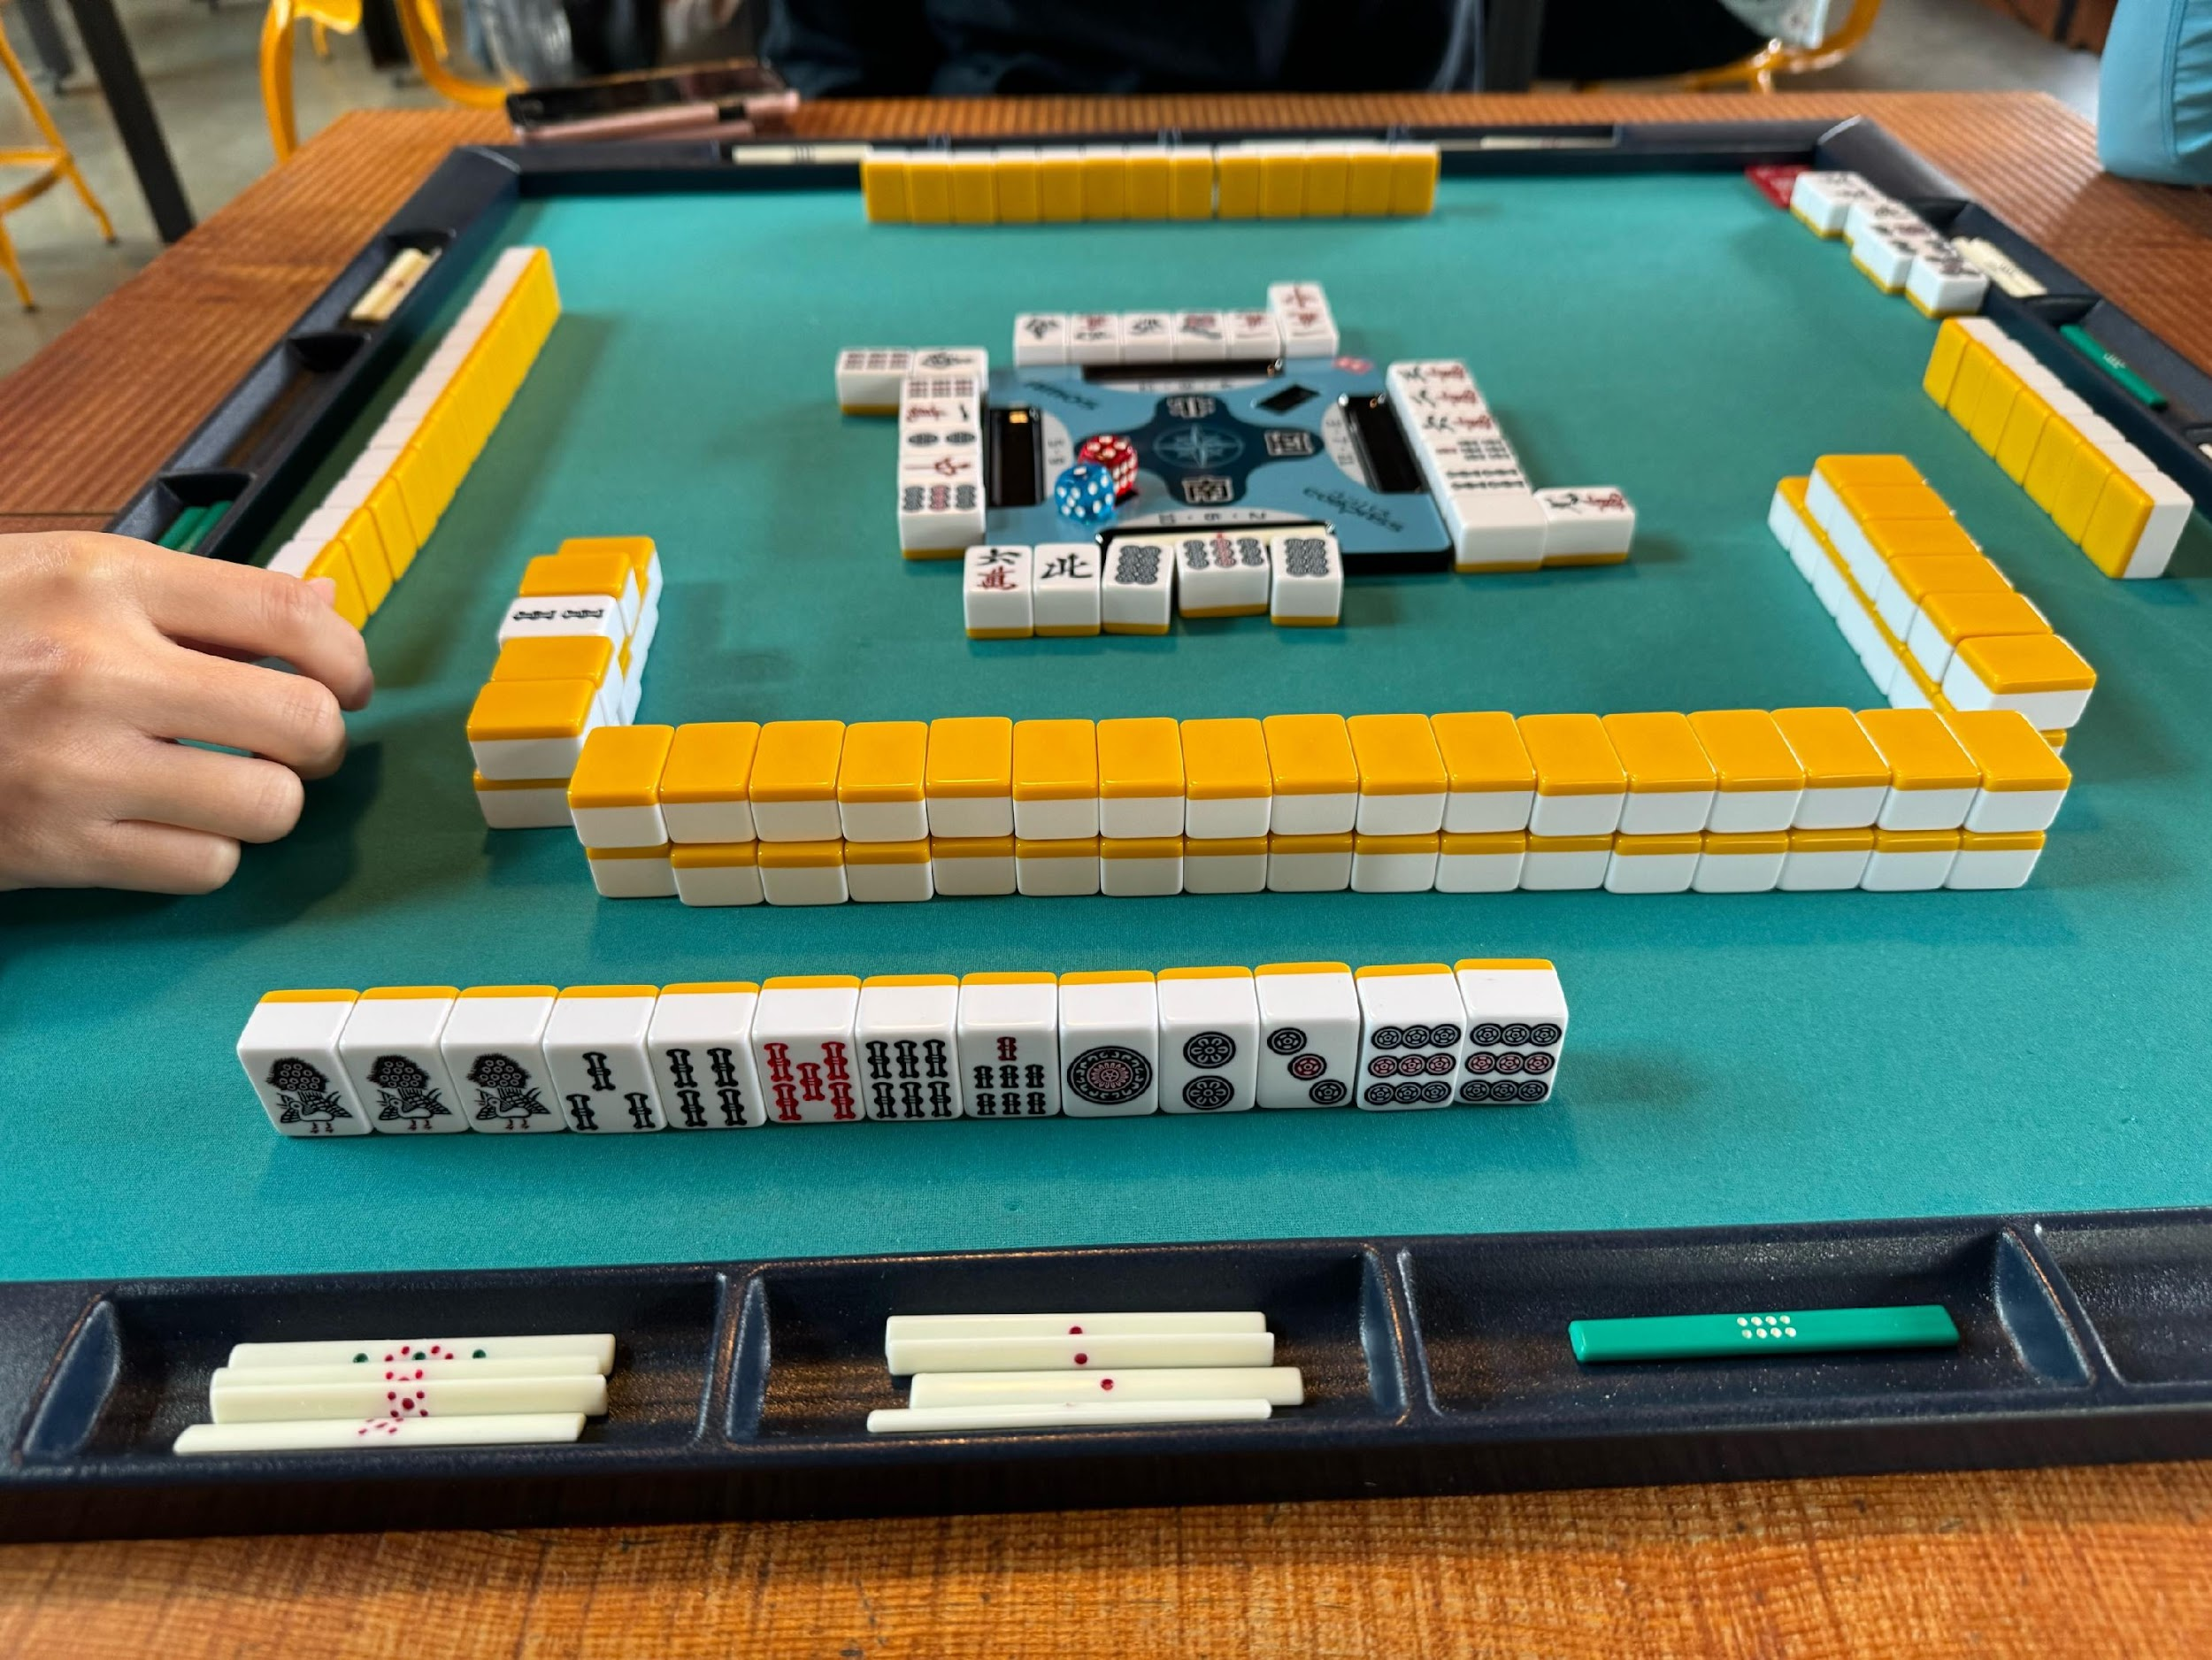

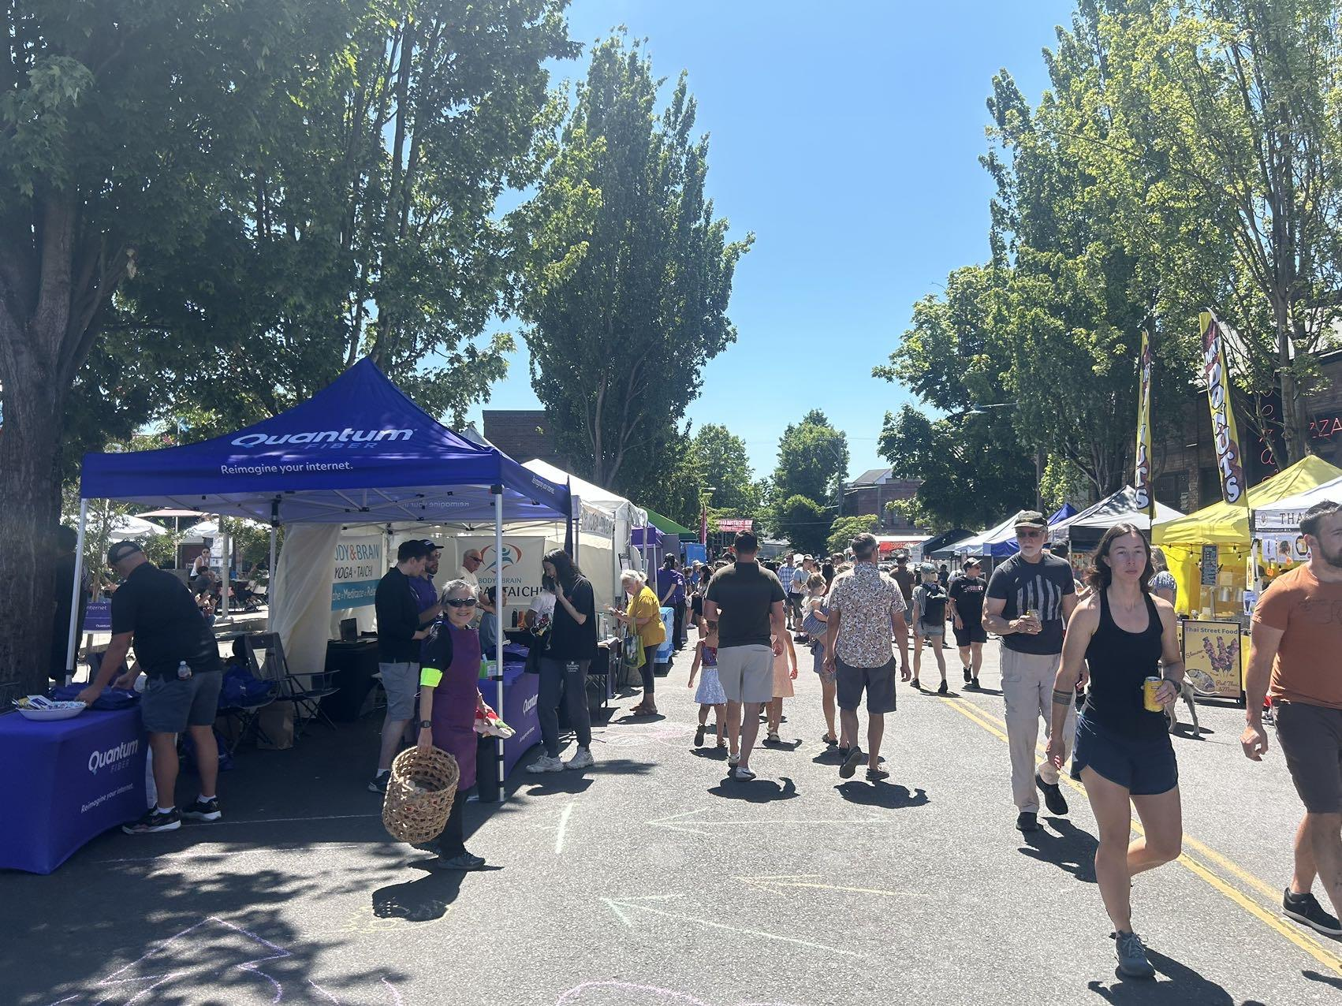

hiking
Hack week
favorite band
Summer Experience
overpriced food
paddleboarding
Riichi mahjong

